Slide 1


New Atlas Portal Layout
The Atlas Science Portal has been upgraded and this has changed the layout of the Atlas landing page as well as the navigation menus on the VISC landing page.
All the previous functionality is still there, only the top level navigation has changed
This PowerPoint will walk you through these new navigation features.

Slide 2
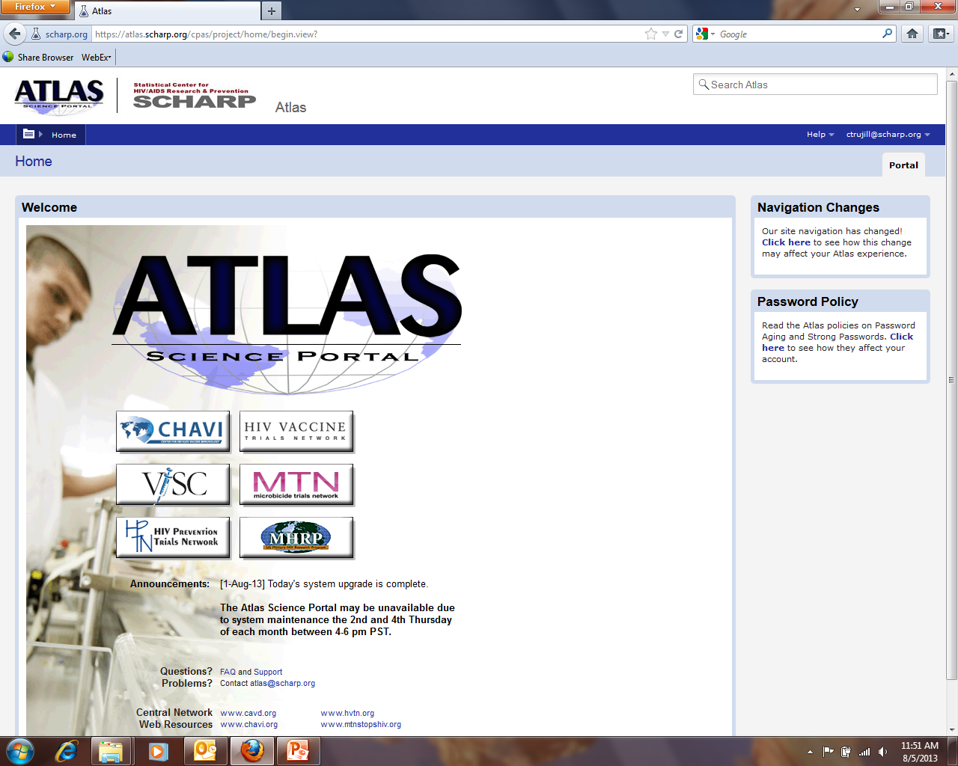
Atlas Home Page
New navigation menu found here.
Can also navigate to the other networks below as well.

Slide 3
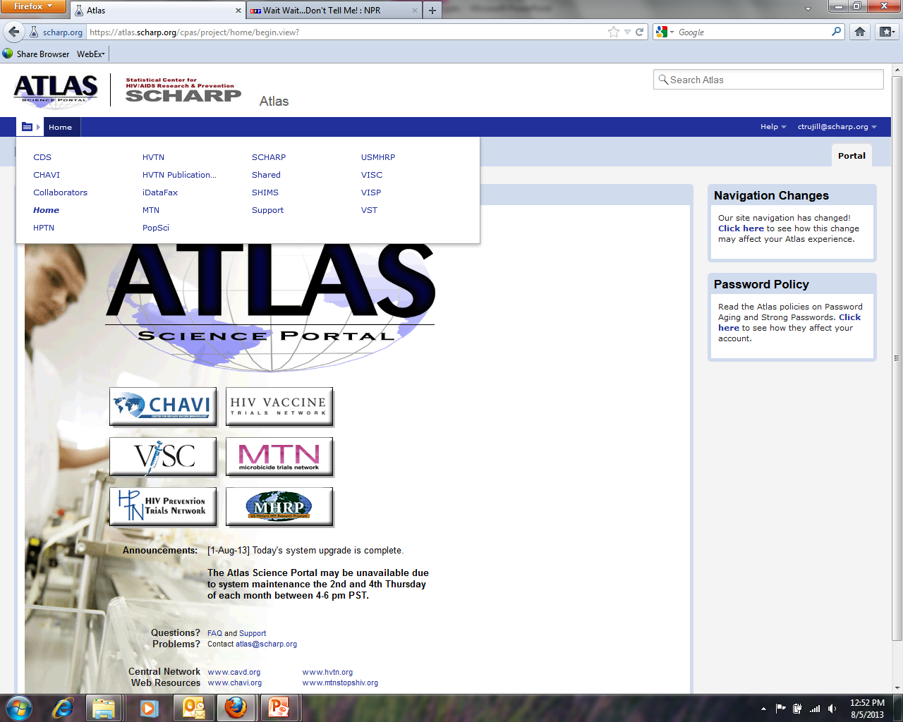
Atlas Home Page
More expansive list of top level projects within Atlas.
Hover over the arrow to expose this list.

Slide 4
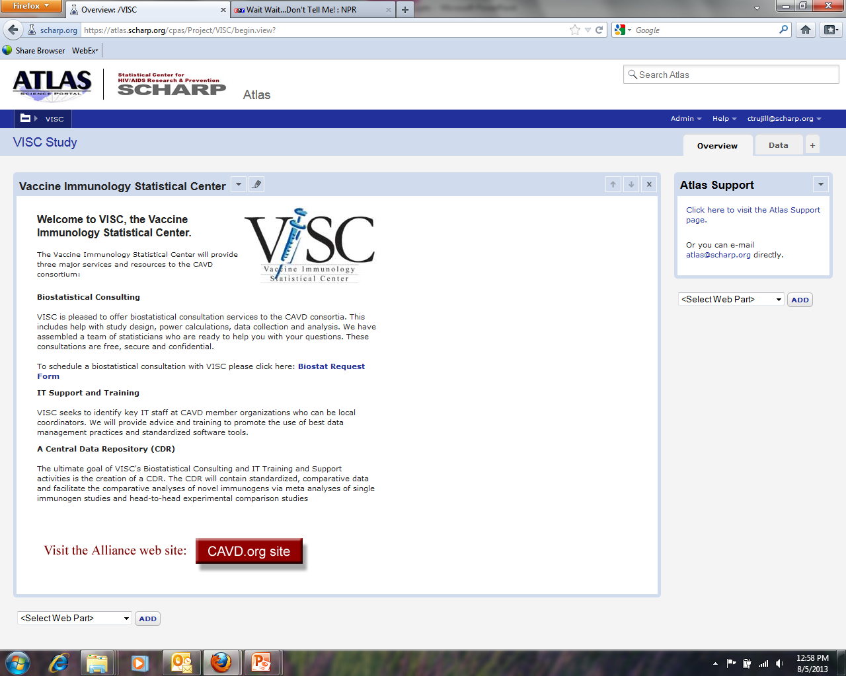
VISC Home Page
Full VISC menu behind this singular menu, hover over the word (VISC) here to expose submenu.

Slide 5
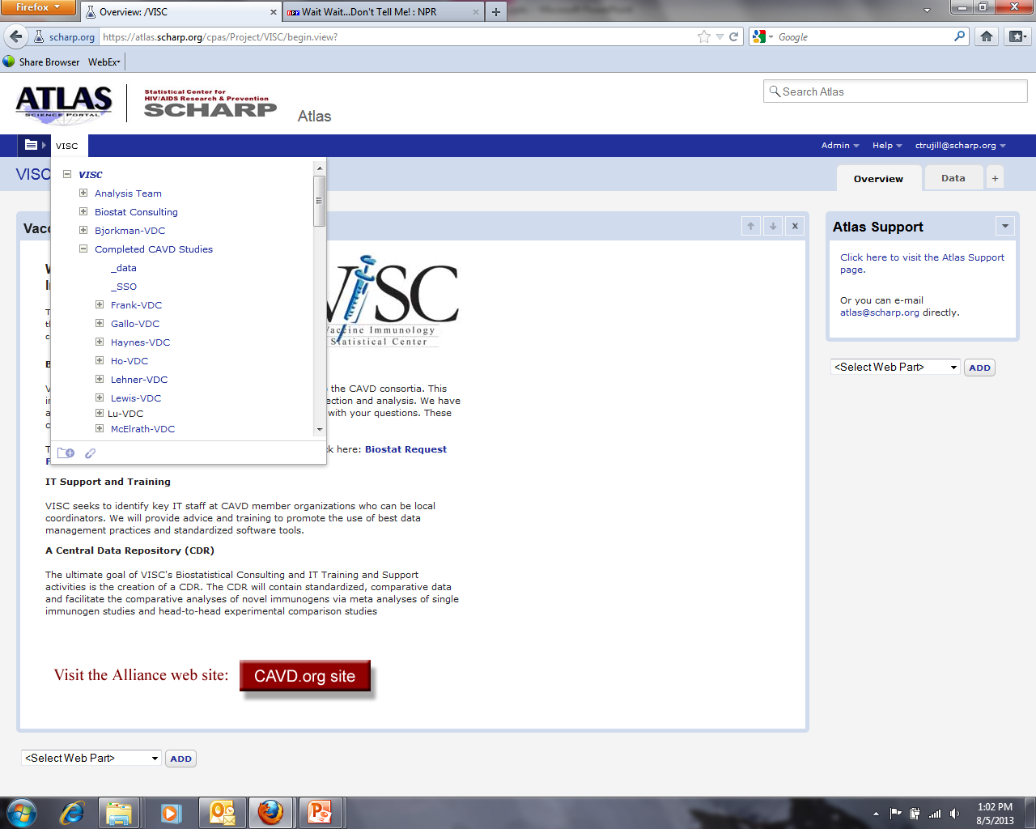
VISC Home Page
Hover over word to expose sub-menu; use scroll bar on side to view the study folders below (listings are alphabetical)

Slide 6
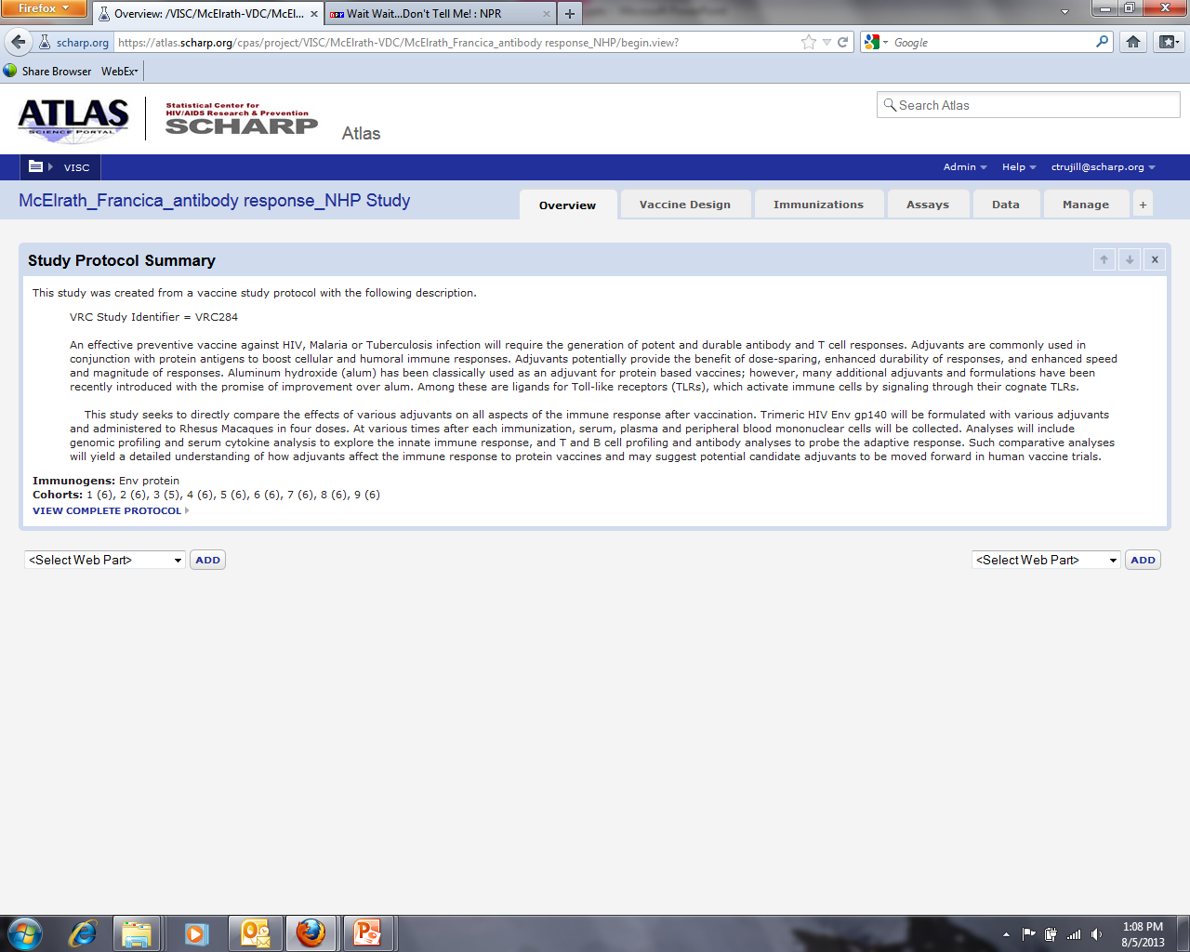
VISC Home Page
Once the study is selected, the navigation and layout is unchanged from previous versions. To access any other studies or networks, select the word (VISC) for studies and select the arrow for the networks.

