Slide 2
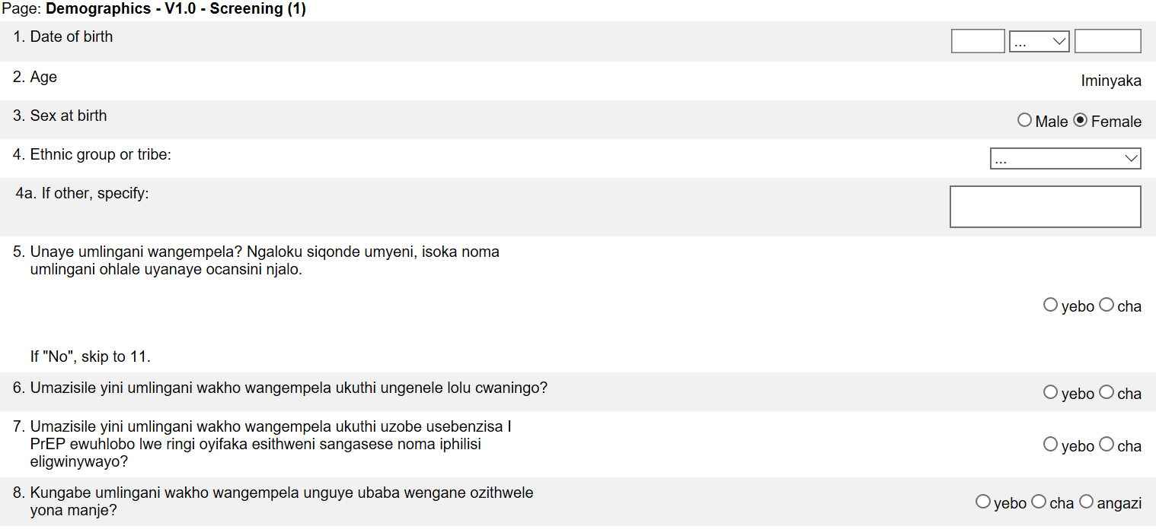
Medidata Translated eCRFs - Local Language
Translated forms will appear to sites in local language (e.g. Zulu), while all data entered is centrally viewable from a single database
The translated form replaces English form
Notes:
The translated version of each interviewer-administered forms is accessed in the same way as the English versions of each eCRF. For example, to access the Demographics CRF, you would still navigate to the V1- Screening visit folder and click on the Demographics eCRF for form completion. In order to see the translated version of the eCRF, an update must be made to your iMedidata User Profile – see next slide!

Slide 3
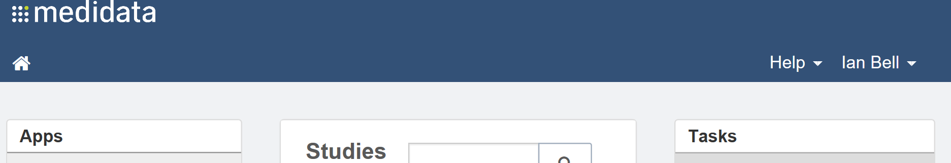
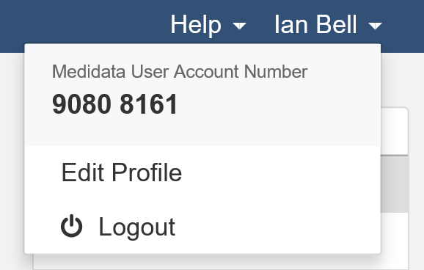
Medidata eCRFs Translations – Setting Locale
How to access translated forms:
1) Log in to www.imedidata.com
2) Navigate to profile (“Edit Profile”)

Slide 4
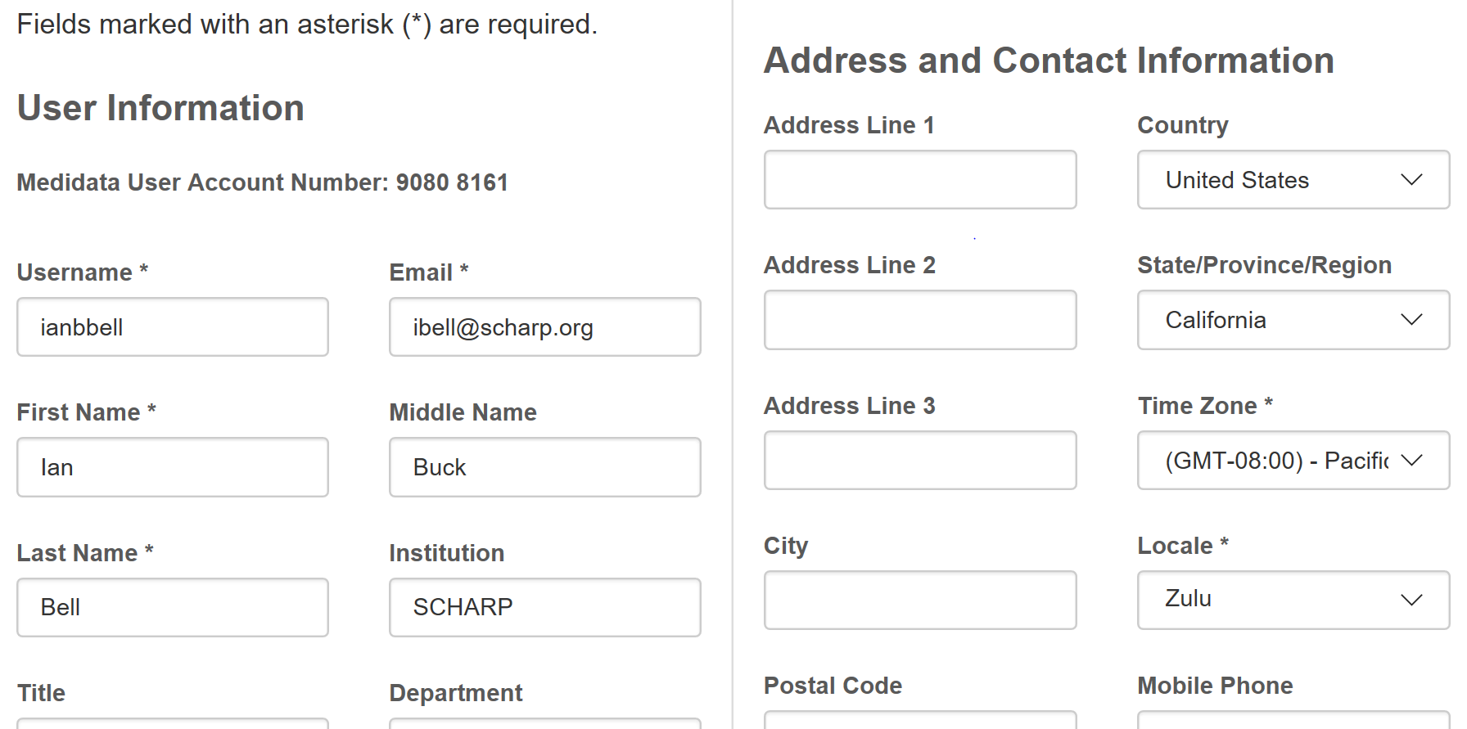
Medidata eCRFs Translations – Setting Locale
How to access translated forms continued:
3) Select applicable language from Locale* drop-down menu and click “Save”

Slide 5
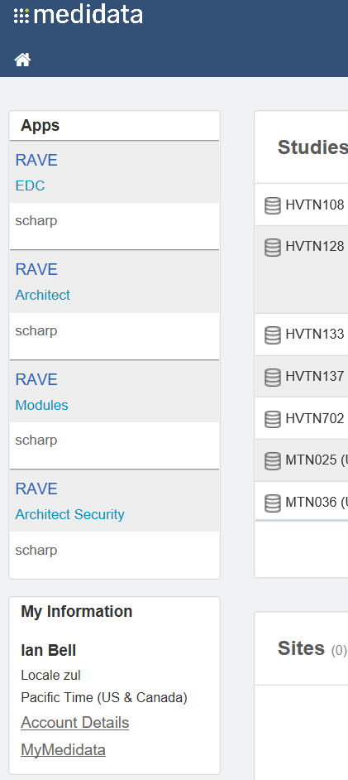
Medidata eCRFs Translations – Setting Locale
Confirm your current ‘locale’ within the ‘My information” section of your Medidata homepage.
Note: A locale (language) update applies to every study available on the SCHARP Medidata homepage.
Notes:
You can confirm which locale or language has been selected by viewing the locale indicated within the “My information” section of your iMedidata Rave homepage. For example, ‘zul’ indicates that the current locale or language is set to Zulu.
Note that the language is set by your iMedidata profile, meaning that in the above example, any forms that have been translated into Zulu for all of the studies for which you have access will be viewable in Zulu. For example, if you have Zulu translated forms in MTN-042 and MTN-043, the Zulu translations for translated eCRFs for both studies will be viewable when your profile locale is updated.

Slide 6
Medidata eCRFs Translations - Local Language
Because changes to the profile locale/language affects all participants across all SCHARP housed studies, the user profile will need to be updated and resaved each time to the applicable language.
  Example: participant 1 comes in for her Screening Visit and prefers to complete the Demographics CRF in Zulu. The profile should be updated so that the selected locale is Zulu before navigating to the form within this participant’s casebook.
  Example: participant 2 comes in for her M9 visit on and prefers to complete the Social Benefits and Impacts CRF in English. If the same staff member is conducting the interview, then they need to update their profile so that the selected locale is English before navigating to the CRF within this participant’s casebook.

Slide 7

Medidata eCRFs Translations - Local Language
Provide a brief note within the participant’s chart to document the participant’s preferred language in which each eCRF is administered.

Slide 8
Notes:
Please send any questions about translated eCRFs within Medidata Rave to MTN-025 SCHARP CDMs.

