Slide 1

REACH: Data Management Quality Reports
Jennifer Schille, SCHARP CDM
November 2019

Slide 2
Overview Topics
Report Overview
Accessing the DMQ Reports
Metrics and Definition of Terms

Slide 3
Data Management Quality
(DMQ) Reports
Summarize data management and data quality metrics for data submitted via Rave.
2 types of reports:
  Monthly – summarizes data for the current month
  Cumulative – summarizes data from the time the study opens
Resource for sites to help monitor and track data quality
Located on MTN Atlas Portal: https://atlas.scharp.org/cpas/project/MTN/begin.view?

Slide 4
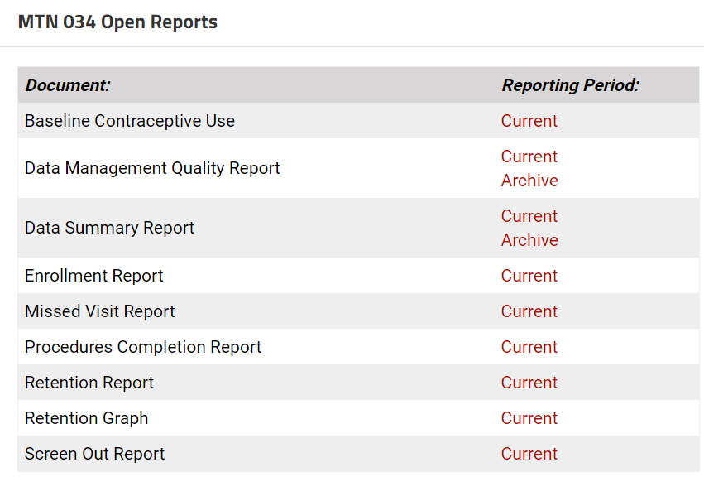
Accessing DMQ Reports
Log into the MTN Atlas Portal
On MTN main page, find MTN 034
DMQ Report listed under MTN 034 Open Reports

Slide 5
DMQ Metrics
    All of the Metrics used for the DMQ Report can be found within the DMQ Report under “Definition of Terms”, however a few things to clarify are on the following slides

Slide 6
Queries answered on time
  Defined as the Total # of Queries Answered with a site answer date that is 7 days or less from the query open date.
      Query open date: date on which the query was opened
      Query Response date: date on which the site responded to the query

Slide 7
AEs entered on time
  Defined as the # of AEs Entered within 3 days of the “Date AE Reported to Site”
  Calculated by comparing the AE log line data entry date (i.e. the earliest date that data was entered for its completed data fields) with the AE “Date AE Reported to Site”
      Date Reported: date on which AE was reported to site
      Date Entered: date on which the site entered the AE

Slide 8
Pages entered on time
  Defined as the percentage of CRFs entered into the Rave database where the initial Data Entry Date is less than or equal to 7 calendar days of the visit date.
      Uses defined Visit date and the Initial data entry date

Slide 9
Pages included in Time Metrics
    Folders not included: Screening visit, Ongoing Logs, all inactivated forms and missed visits.
    Other forms not Included: Local Lab, HIV, STI results etc.
      A more thorough listing of what CRF are excluded from this report can be found in the DMQ Report under the ‘Definition of Terms’ page after the Cumulative Report

Slide 10
QC Counted or Not?
  Site from System
    Not counted ☺
  Site from DM
  Site from Safety
  Site from Coder
    Counted ☹

Slide 11
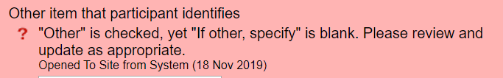
Site from System queries
NOT counted in the DMQ Report metrics.
Example: when “Other” is marked, and the “If, other, specify” is left blank, a Site from System query fires, this would not be counted in your sites QC rates.

Slide 12
Site from System queries
Another example: an invalid QC is firing that SCHARP needs to update as part of a database migration. This would trigger as a “Site from System” edit check, but since the “type” of QC is Site from System, these will not affect your QC rate.
  Respond to these so they are no longer in your task list
  OR
  Ignore and SCHARP CDM will cancel
    Once the database is migrated, these should no longer appear

Slide 13
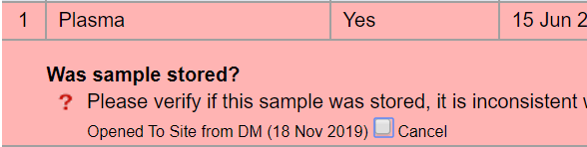
Site from DM/Safety/Coder
“Site from DM/Safety/Coder” ARE counted in the DMQ Report metrics.
Example: the CDM or the Clinical safety specialist at SCHARP applies a QC for clarification:
  This type of QC will appear as below but it will say either, DM, Safety or Coder, depending on the QC

Slide 14
Site from DM Queries
  SCHARP CDM is aware these are “counted”, we try our best not to place too many of these types of QCs, however:
      There are times when a QC issue pops up, and we need to do a “clean-up”; there may be a surge in QCs placed to correct the issue and you might see your sites QC rate go up. This is expected in these cases.
      If this is not the case and the QC rate for “Queries answered on time” stays below 80% for 2 months in a row, a refresher training may occur to help with any issues you might be having with data entry/QC resolution.

Slide 15
RAVE Query Reports
MTN 034 Open Queries Report
  Can be useful to generate a listing of open queries for your site
  All staff who have Clinical Research Coordinator Role access should have access to this report
      If not, please contact your SCHARP CDM for assistance

Slide 16
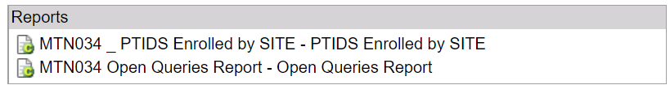
Rave Open Queries Report
Found on the Home page for MTN 034
  Will show open queries for your site
  Can be downloaded and sorted in Excel if needed
    If there are issues running this report, try a different web browser!

Slide 17
Thank you!
If any further questions, please contact your SCHARP CDM: Jenn Schille: jens@scharp.org

