Slide 2
Medidata Rave Reports
MTN-030
July 2017

Slide 3
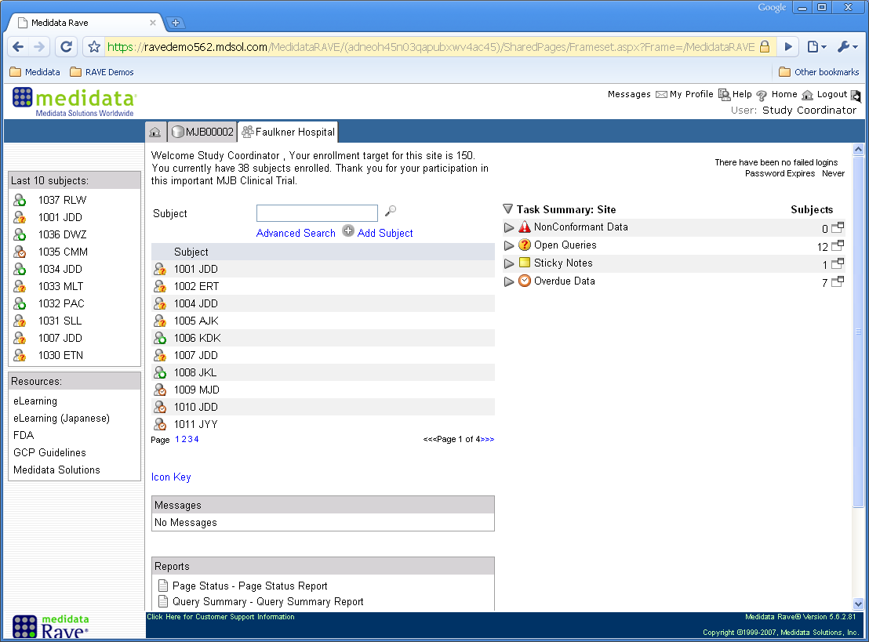
Medidata Rave Reports
Assigned Reports
Notes:
Standard Rave reports will be available on the homepage of your MTN-030 site homepage once an online eLearning for Reporter has been completed. The standard Rave reports will be viewable at the bottom of the homepage below the list of your participants.

Slide 4
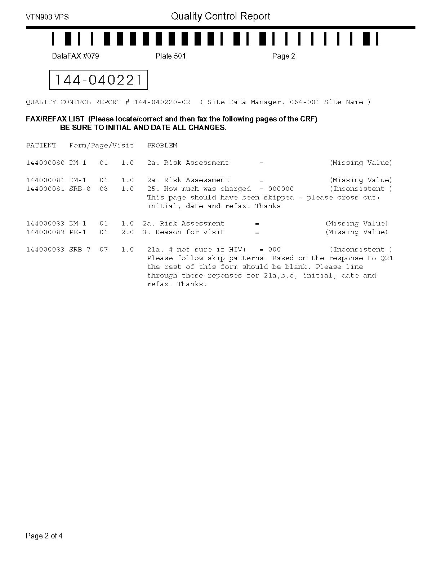
Rave Query Reports
QC Reports will no longer be sent via email to each HOPE study site once a month for site review.

Slide 5
MTN-030 Rave Reports: Data Review
The following standard reports will be available within the HOPE Rave database:
Productivity Report
Query Details Report
Query Summary Report
Comprehensive Page Status Report

Slide 6
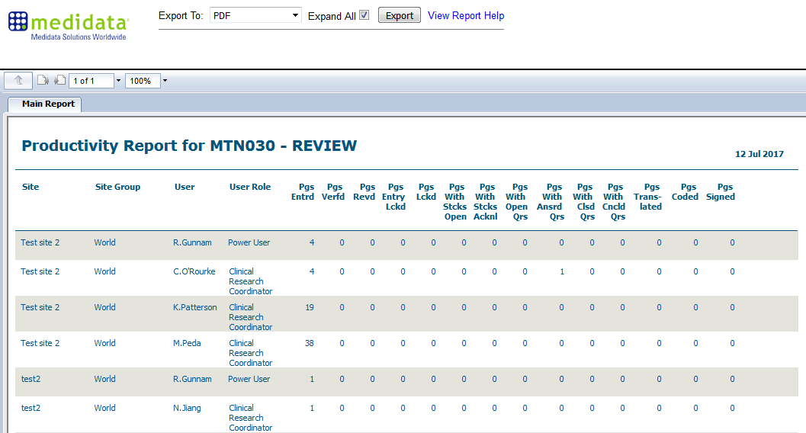
Productivity Reports Overview
Notes:
Example report of test data from the MTN-030 Review database.

Slide 7
Productivity Reports Overview
Provides key metrics on staff Rave utilization
Displays activity per user actions completed in the past within Rave
Provides details on the following activities performed by each Rave user:
    Pages entered
    Pages verified
    Pages reviewed
    Pages entry locked
    Pages locked
    Pages with Open Queries
    Pages with Answered Queries
    Pages with Closed Queries
    Pages with Cancelled Queries
    Pages coded (AE and Con Meds Log pages)
    Pages Signed (by site IoR or designee)

Slide 8
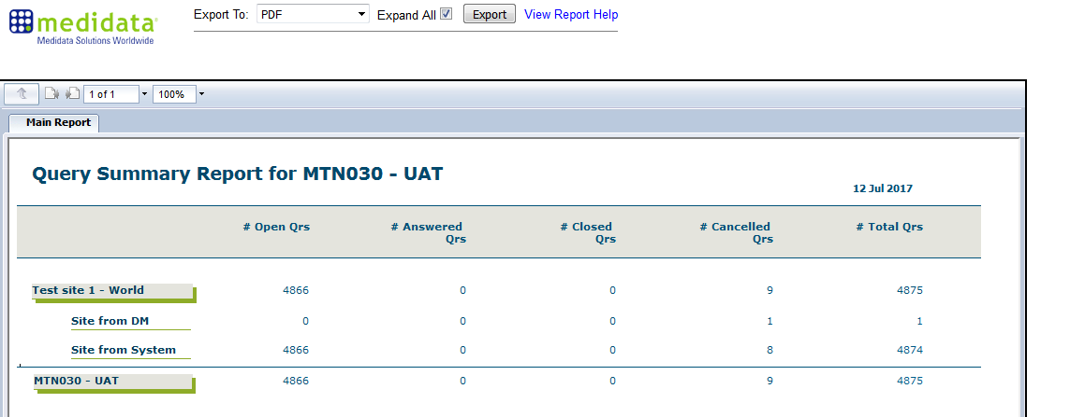
Query Summary Report Overview
Notes:
Example report of test data from the MTN-030 UAT database.

Slide 9
Query Summary Report Overview
The Query Summary Report provides query metrics by site.
The Query Summary Report is a study data monitoring report that displays a count of the number of queries that are generated throughout a study - Open, Answered, Closed, Cancelled, and an overall total grouped by site and role.
Your specific role in with Rave will affect the types of queries that you can view.
    E.g., Site cannot view queries that are placed between the monitor (PPD) and SCHARP

Slide 10
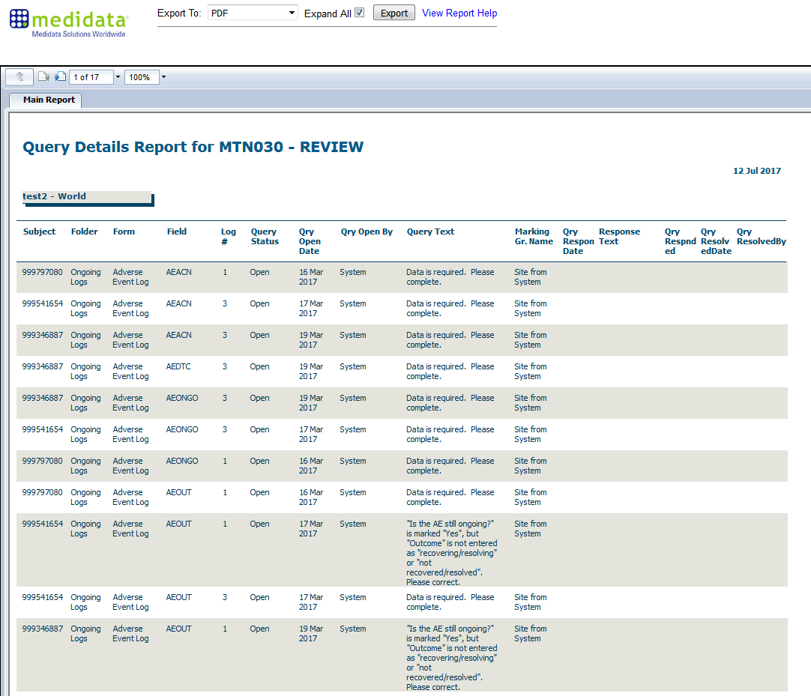
Query Details Report Overview
Notes:
Example report of test data from the MTN-025 TRAIN database.

Slide 11
Query Details Report Overview
The Query Detail Report provides details of a query by site.
The Query Details Report is a study data monitoring report that provides a detailed grouping of the queries by Query status, Query user, marking group, field, form, folder, subject, site group, and site.

Slide 12
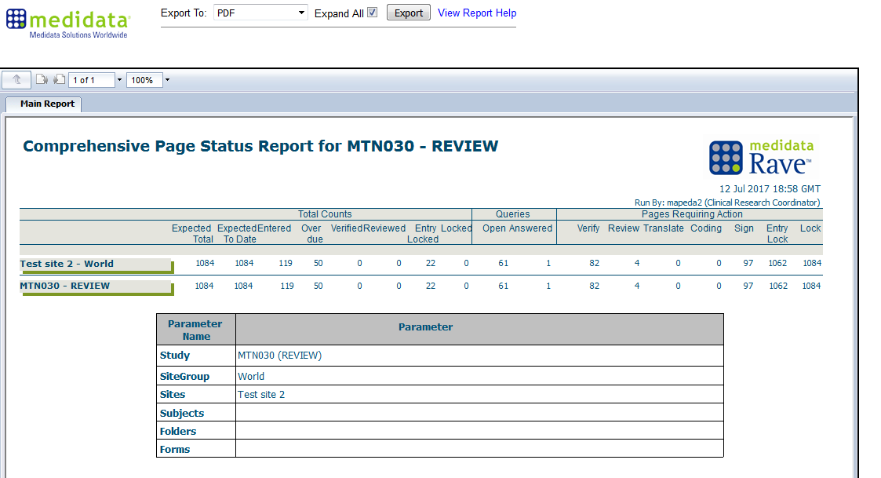
Comprehensive Page Status Report Overview
Notes:
Example report of test data from the MTN-030 Review database.

Slide 13
Comprehensive Page Status Report Overview
The Comprehensive Page Status Report provides a summary of the current statuses of all the CRFs within a specified study, site, participant, folder, and/or form.
A ‘page’ in this report (or any standard report) corresponds to a CRF in Rave, whether that CRF contains standard fields, log fields, or both. The report shows, in a tabular format, the relevant statistics for the CRF.

Slide 14
Comprehensive Page Status Report Overview
The default summary table provided when the report is generated is a summary of page (CRF) status for all HOPE participants at a site.
This is report is a ‘nested’ report and a summary can be provided by PTID, by visit folder, and by CRF within a visit folder, by clicking on the report.
  Let’s see an example!

Slide 15
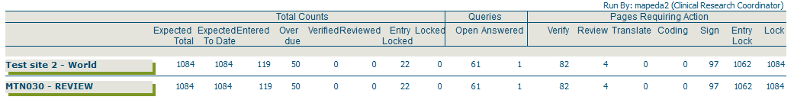
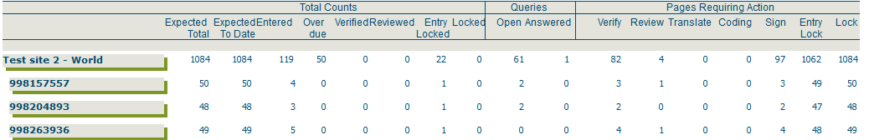
Comprehensive Page Status Report Overview
Summary of page status for site:
Click anywhere on the site line, to show page status by PTID
Click anywhere on a PTID line, to show page status by visit folder
Summary of page status by PTID:

Slide 16
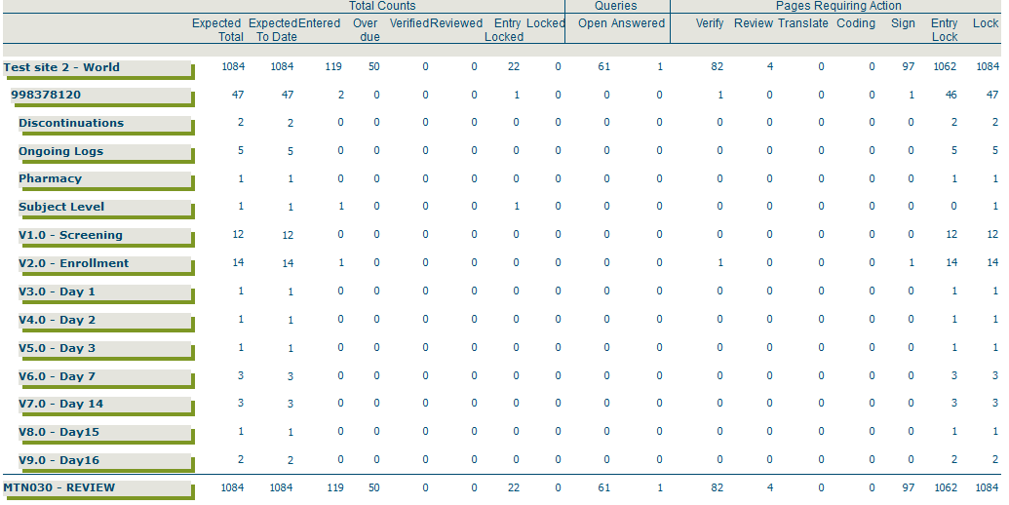
Comprehensive Page Status Report Overview
Summary of page status for each visit folder:
Click anywhere on a visit folder line, to show page status by visit folder

Slide 17
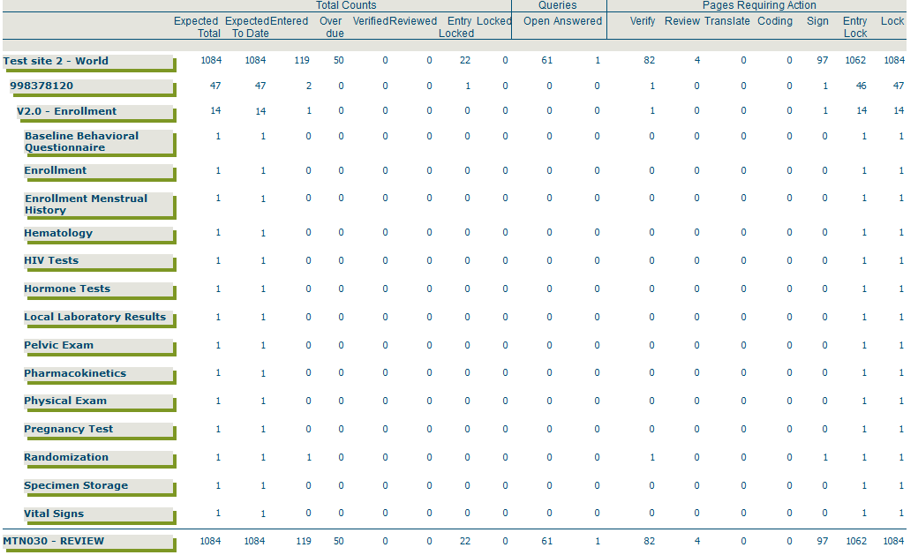
Comprehensive Page Status Report Overview
Summary of page status with a specific visit folder:

Slide 18
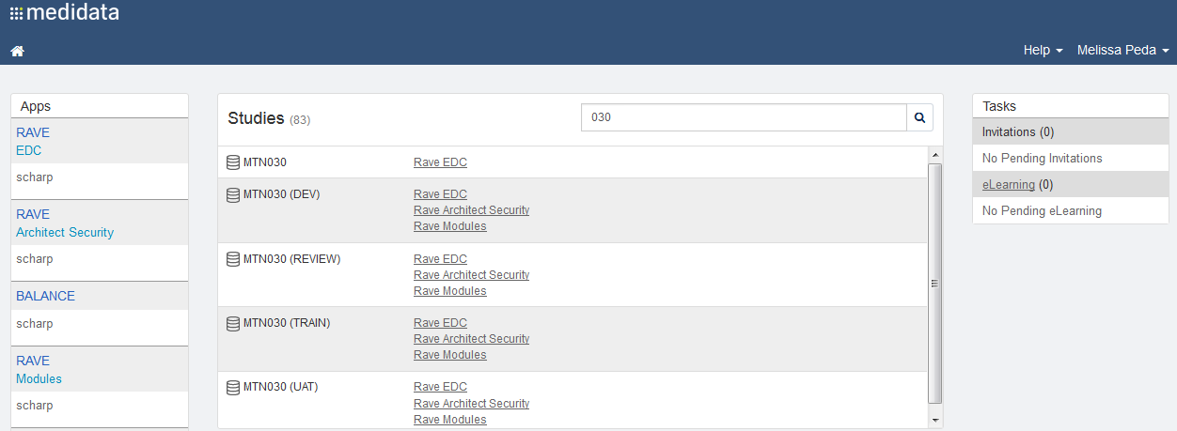
Medidata Rave Reports
Assigned staff members at each site will have access to these reports
The Reporter eLearning module will automatically be added to your homepage to complete (no email is sent from iMedidata)

Slide 19
Medidata Rave Reports
Should additional data team staff members need access to the these reports, please send this request to sc.acces.medidata@scharp.org
Rave reports can be downloaded and save locally on site computers as PDF, csv, or excel files
For more information about each of these reports, go to:
https://learn.mdsol.com/rave/reports/en/rave-comprehensive-page-status-report-81639665.html.

Slide 20
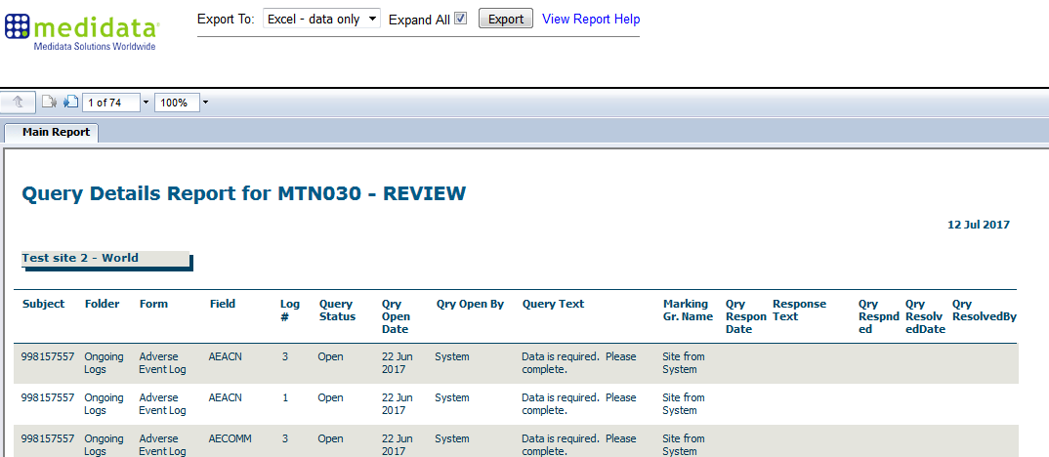
Downloading Rave Reports
Rave reports can be downloaded and save locally on site computers as PDF, csv, or excel files

