Slide 1



Medidata Rave Start-up Information
Statistical Center for HIV/AIDS Research & Prevention (SCHARP)
Fred Hutchinson Cancer Research Center

Slide 2

Presentation Overview
System requirements
User accounts
Account activation
eLearning modules
Site roles
Next steps

Slide 3
System Requirements
To access and use Medidata Rave, you need:
  Internet-enabled computer/laptop/tablet
  Internet Connection
  Web browser

Slide 4
User Accounts
Sites provide staff names and roles to SCHARP Clinical Data Managers (CDMs)
SCHARP sets up user accounts
Users receive e-mail invitation from iMedidata system to activate account
  Check junk or spam folder if needed

Slide 5
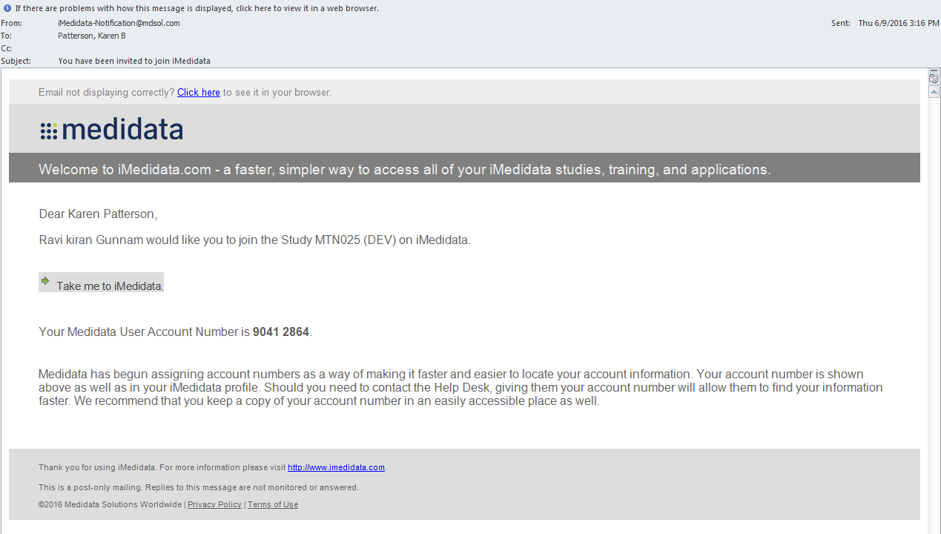
Rave Invitation E-mail
Notes:
Contains user-specific information

Slide 6
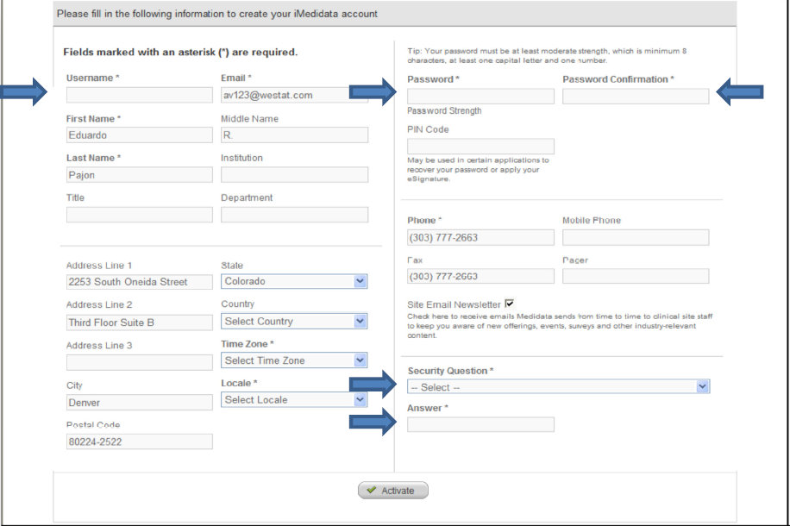
Account Activation
Clicking on link in e-mail will take you to the account activation page
Notes:
Complete the Username, Password and Password Confirmation fields. Your password must be at least 8 characters now and have at least one capital letter and one number to be accepted by the rave system. Choose a security question and
give an answer. Click the Activate button.

Slide 7
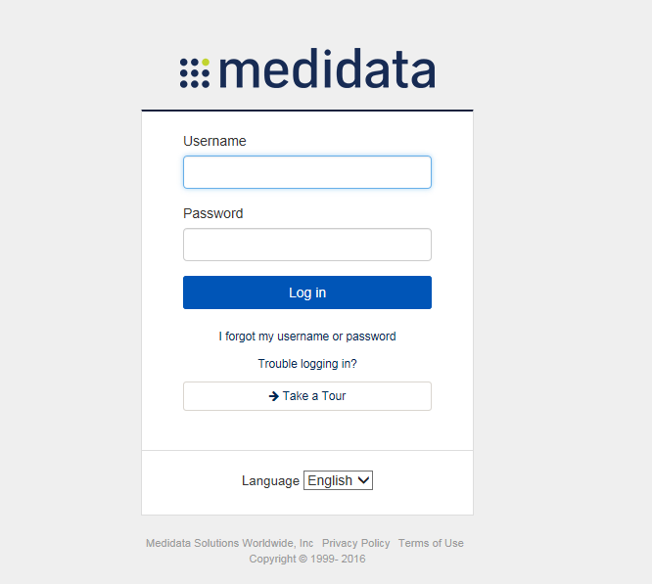
iMedidata Portal
Click “Activate” and iMedidata portal appears
Log on using user name and password you just set up
  Remember for future access (www.imedidata.com)
Notes:
You can bookmark imedidata.com as a favourite on your web browser for easy access during the study. You will navigate to this imedidata website for access to the HOPE database and other study materials during the study.

Slide 8
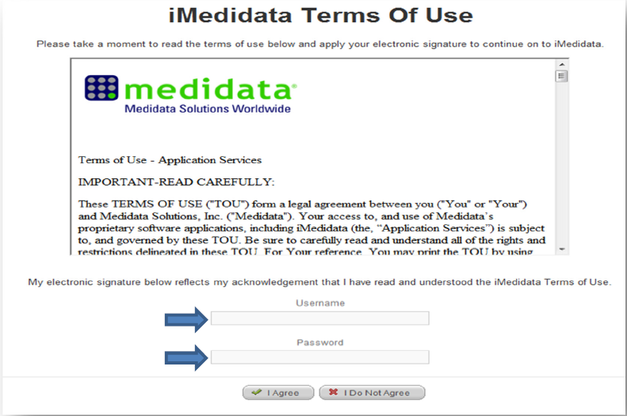
Terms of Use
eSign this agreement one time. Use the username and password you just set up

Slide 9
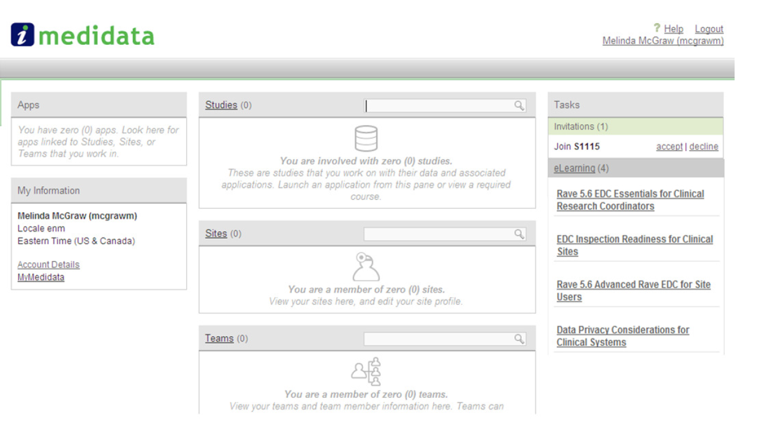
Accept Test Database Invitation
  Begin familiarizing with database structure, enter test data, ask questions, plan ahead

Slide 10
Complete eLearning Modules
Links to eLearning modules will appear on screen
Click each module to run the course
  Completion is required to access the study database
  Exercises included in each module
  Credit for completion applies across studies in Medidata Rave (only need to complete each module once)

Slide 11
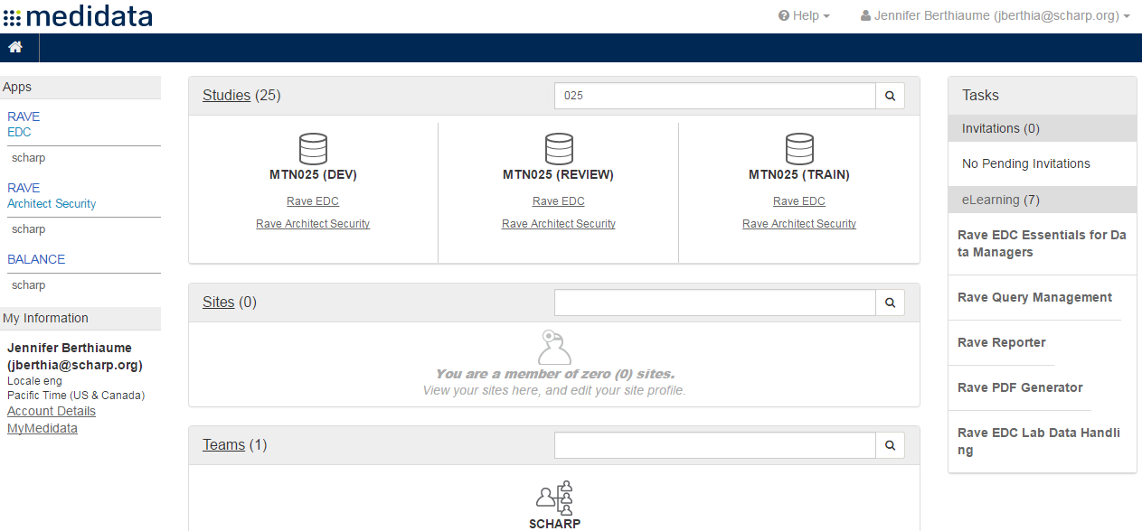
Your eLearning Modules
Notes:
Assigned eLearning modules are user-specific, based on role assigned to the user by SCHARP

Slide 12
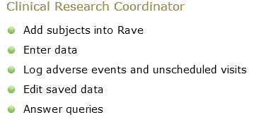
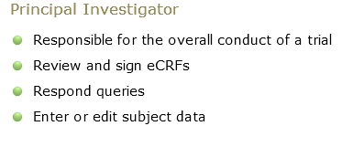
Site Roles in Medidata
Assigned modules and Rave permissions based on roles assigned in Medidata

Slide 13
Site eLearning Modules
Module for Study Coordinators
  EDC Essentials for Clinical Research Coordinators (required) – 45 minutes
Module for Investigators
  EDC Essentials for Investigators (required) – 20 minutes
Module for Read-only Users
  Rave EDC Essentials for Read-only Users

Slide 14
Next Steps
Determine what user accounts are needed for your site and notify SCHARP
SCHARP will set up required user accounts for your site
Each user activates his/her account and completes assigned eLearning modules
SCHARP sends users invitation to HOPE development (TRAIN) database
Users accept invitation to test database
Notes:
The HOPE TRAIN database is a practice database that you can use to become accustomed to how the HOPE database will look and practice navigating around the different components of the database. You will also have an opportunity prior to study start to practice completing eCRFs, entering dummy data, and finding and resolving queries.

Slide 15
Support
Contact SCHARP Clinical Data Managers
  Jen Berthiaume (jberthia@scharp.org)
  Melissa Peda (mapeda@scharp.org)
  Carol Tranfaglia (ctranfag@scharp.org)

Slide 16

Questions?

