Slide 1



Transition to MediData Rave
MU-JHU UGANDA experience
Dr. Carolyne AKELLO on behalf of the MU-JHU team
MTN Annual Meeting
19 March 2017

Slide 2

Presentation Overview
Introduction
Preparing for Medidata Rave
Implementation
Lessons Learned & Challenges
Summary & Looking Ahead

Slide 3
Introduction – The demand…
In 2016: MTN & IMPAACT networks required MediData Rave to be used for new protocols
For MUJHU CRS pioneering studies were:
  MTN-025 or H0PE
  IMPAACT 1115
MTN 025 timelines
  Planning at annual Feb and Sep regional meetings => all sites to migrate to EDC by December 2016

Slide 4

Introduction – Site context…
MU-JHU site in Kampala, Uganda has some experience with edata-management systems :
  iDataFax
  Cactus
  REDCap
EDC new system from 2016
  MTN-025 with SCHARP DMC
  IMPAACT 1115 with FSTRF DMC
  Other IMPAACT and HPTN 084 protocols projected for MUJHU site to use MediData Rave

Slide 5


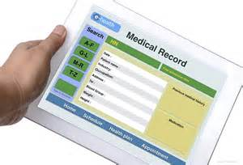
A great opportunity !
Use of represented a significant shift from MTN paper based system with idatafax transfer used before
We embraced it as a great opportunity !

Slide 6

Preparing for Medidata Rave
We engaged in X-cutting and study specific planning involving:
  Site and study leadership
  IT, data, QC, QA & operations
We established an ‘eData transition taskforce’ to manage this as a priority project
  Clear assignments and timelines were set and tracked to ensure completion on schedule

Slide 7
Preparing for Medidata Rave
People
Systems
Infrastructure
We considered shifts required in:
Infrastructure
Systems & processes
Human resources
  Quantitative & Qualitative

Slide 8
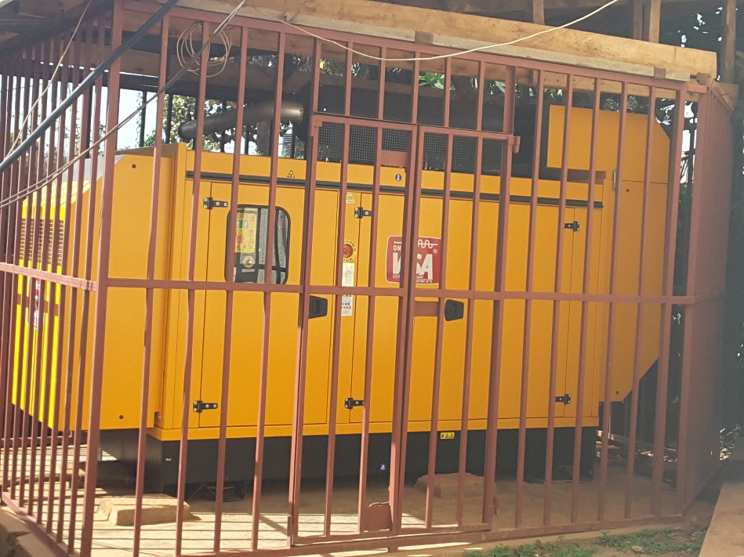

Infrastructure – Power
  CHECK : RELIABLE POWER IN PLACE => no additional needs
  *Thanks to substantial investment with DAIDS support
  Reliable power 24/7 is required
  Main generator (new 2015 shown) & back-up back-up generator for critical areas
  UPS individual and for critical areas
  Emergency alarms and sensors (2015)
  Step-down transformer (March 2017)
    Ensures clean power and protects from surges
Notes:
Upgrades done in ICT/power supply to support EDC

Slide 9
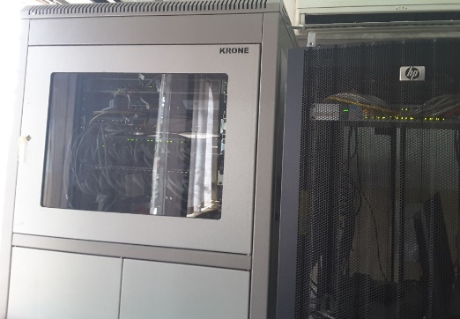

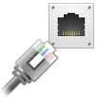
Infrastructure - IT
    We reviewed connectivity and ICT hard/software needs to support robust and reliable connectivity and data storage
Hardware needs
      Consultation with users & IT to define needs & specifications
        Considered individual or shared use, mobile or static & location
      Procurement of desktop computers (5 Dell) & laptops (5 Lenovo)
Internet connectivity and servers
  External links for high speed reliable connectivity
    10 Meg assured link with regional/continental ring for redundancy (2016) and backup link with dedicated 4 Meg
    Capacity to rapidly increase if needed
  Defined need and placement for more internal connections
    Additional hard wiring to provide ethernet ports

Slide 10
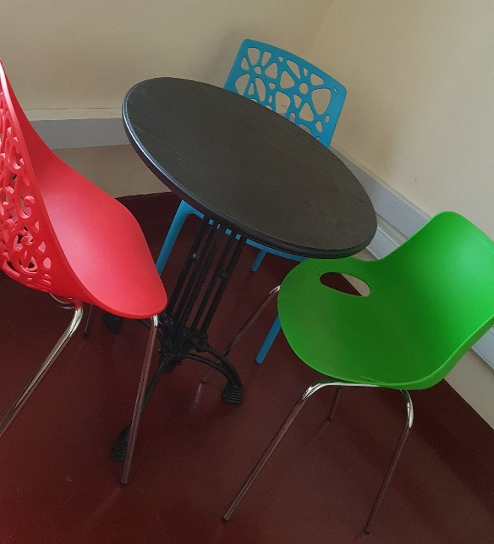
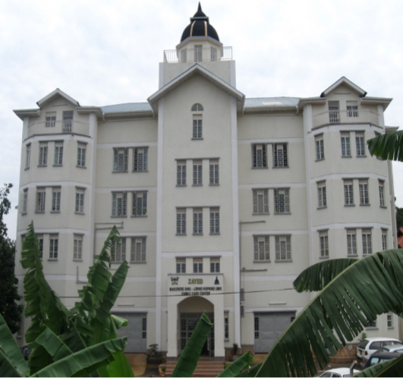
Infrastructure – Study facilities
Dedicated space created for HOPE study (EDC considered)
Initial consultation with team and renovation designed
New counseling rooms
Others to be completed in Q2

Slide 11

Infrastructure planning

Slide 12
Systems & Proceses
People
Systems
Infrastructure
We considered shifts required in:
Infrastructure
Systems & processes
Human resources
  Quantitative & Qualitative

Slide 13
Data Management System
We reflected on shift from old system and processes
Roles – shifts in all roles:
  From receptionist, counselor, clinician, study coordinator, QC-1, QC-11, data entrants, data managers, records clerks to IOR
  System generated queries requiring immediate correction eliminate many user errors
  Requires use of computers for some cadres who had no/limited use in old system (eg QC-1, QC-11, counsellors)
Paper–based file – still needed for information NOT captured
Identified need to review and update site CQMP in view of EDC
CHANGE MANAGEMENT +++ is required to embrace new system

Slide 14
Preparing for Medidata Rave
People
Systems
Infrastructure
We considered shifts required in:
Infrastructure
Systems & processes
Human resources
  Quantitative & Qualitative

Slide 15
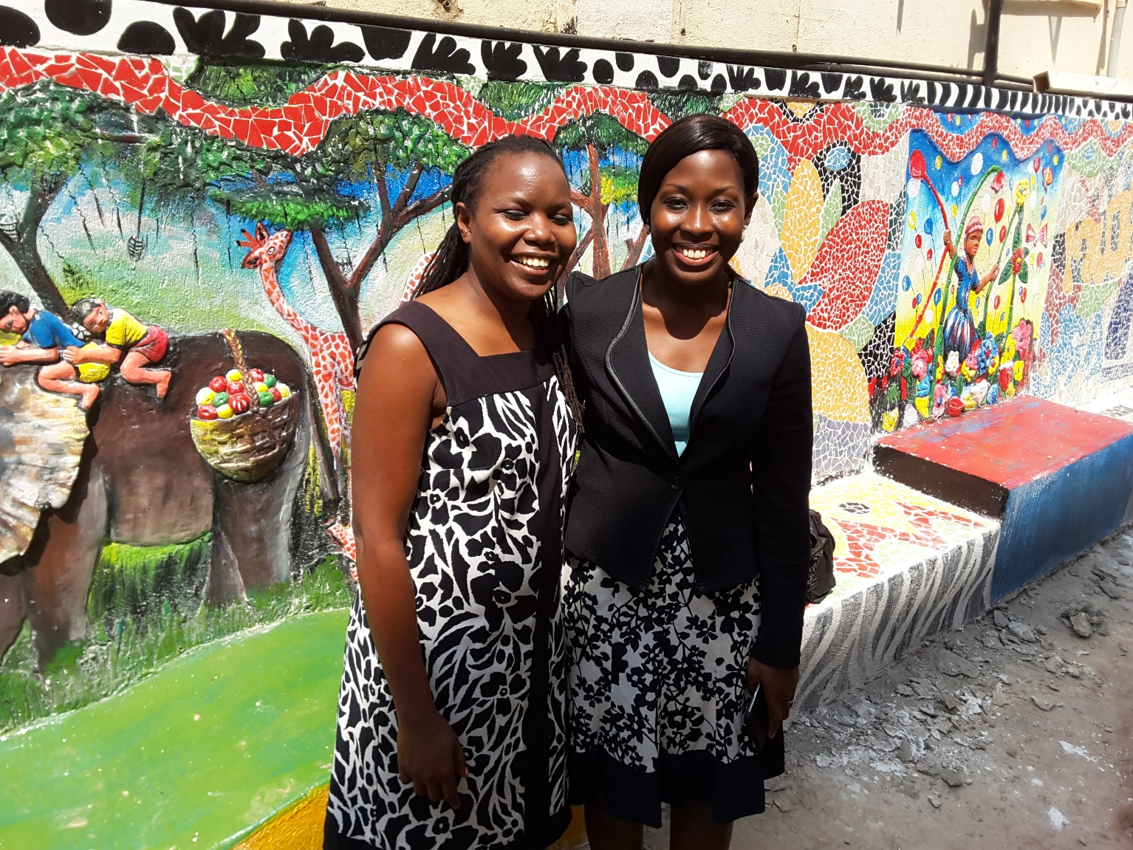
The most valuable asset = people
Working together with their heads and hearts !
HOPE PoR and Study Coordinator

Slide 16
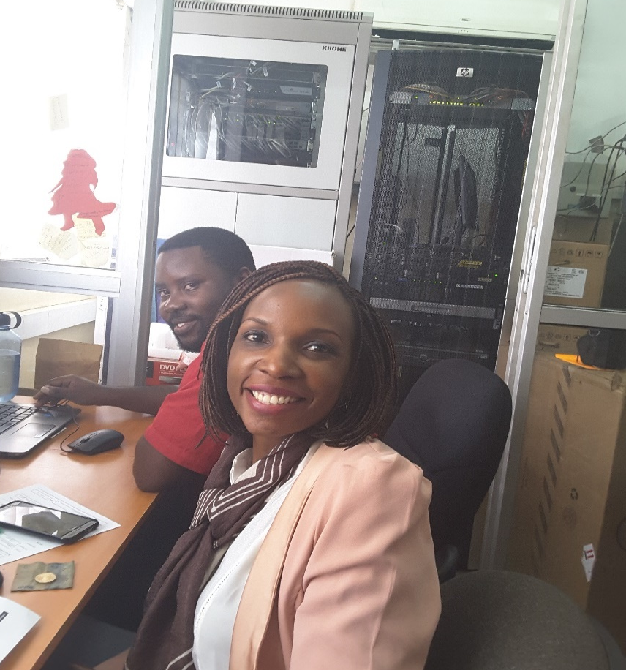
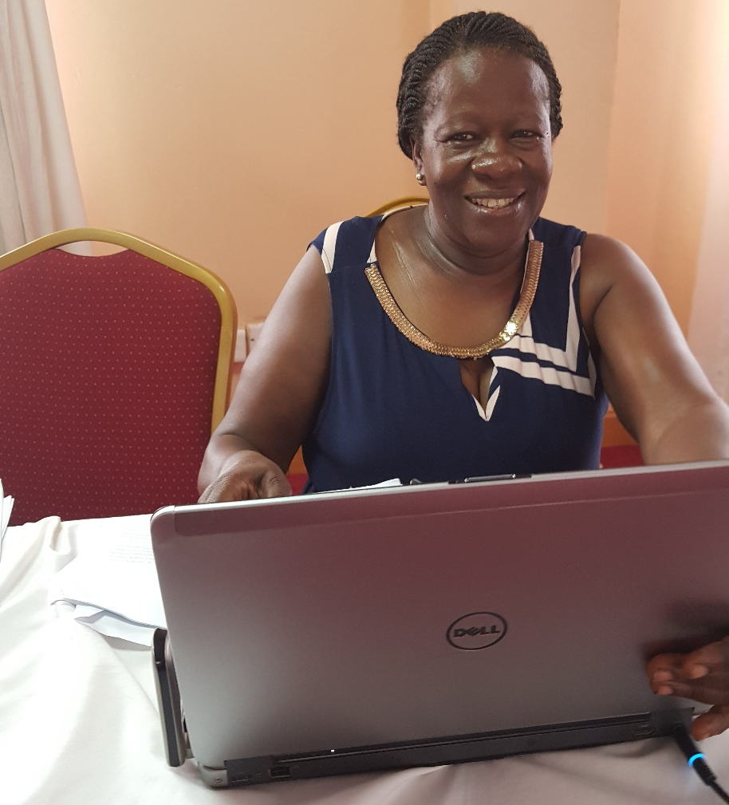
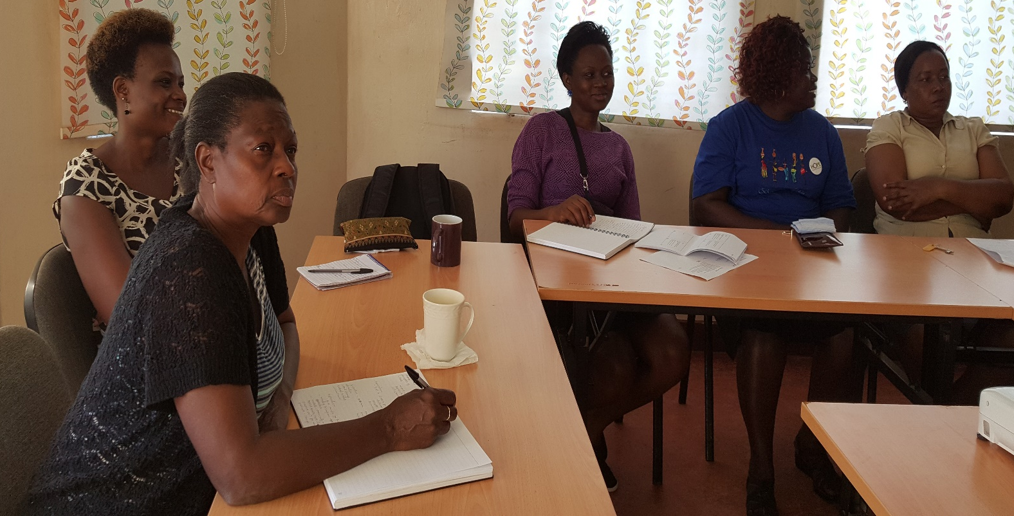
IoR with IT
Site MTN Lead
Site IOR & IT
Community team and counsellors

Slide 17

  MU-JHU HOPE & X-cutting staff
  Identified roles in relation to Medidata Rave through process mapping & definition of individual roles
  Identified individual training/support needs
    Data team and IMPAACT 1115 team had already done e-learning course for Medidata Rave
    Staff already proficient in computer use
    Staff completed e-learning modules & on-site pilot testing and review of competencies
  Source Documentation SOP made clear
    eCRFs Vs Paper CRFs
  Commitment to ongoing learning and improvement
  Team enthusiastic about using Medidata Rave +++

Slide 18
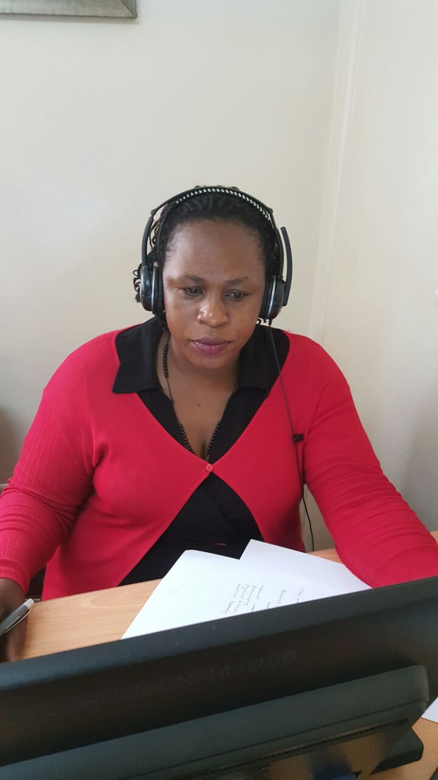
Medidata Rave Training…
ID#: DSO374200022313
Medidata Solutions certifies that
Joselyn Nabisere
has fulfilled all requirements to be recognized as a
Medidata Rave® Certified Clinical Research Coordinator.
October 03, 2016
Nurse Study Coordinator

Slide 19
Prepared for Medidata Rave !
People
Systems
Infrastructure

Slide 20
Implementation (1)
Smooth implementation so far !! ☺
MUJHU was site activated for HOPE screening and enrolment on 05 Nov 2016
  Follow Source Doc and Data Management SOPs
  Streamlined generation of HOPE PTIDs
    By Data Manager only
  CRF completion guidelines were very helpful
    Hard copies referred to by all staff entering data

Slide 21
Paper CRFs
Type of Visit | Comment
Screening Visit | Paper CRFs filled for participant screening Visit only populates in EDS after eligibility criteria CRF is filled at participant enrolment Data team enter screening visit after participant enrolls
Enrolment Visit | Initially we had paper CRFs for all the forms filled at and after enrolment in order to gain confidence in EDC From Jan 17 we entered directly into EDC in real time
Behavior Assessment CRFs | English CRFs are entered directly into Medidata Rave Delay in entry of Luganda CRF (awaiting upload - expected soon) – until then paper CRFs are entered in English into EDS after visit by data team
Non CRF source forms are paper-based: lab results forms, prescriptions, certified FP card, chart note, baseline conditions & AE follow-up form etc

Slide 22

Lessons Learned (1)
It worked well to approach the transition :
  As a site-wide priority not just as a study priority
  Engage key users as part of a multidisciplinary team
  Integrate change management & ongoing learning processes
The QC resolution process was streamlined
  Systems queries are resolved immediately by primary data collector that created them
  QC team members responsible for resolution of manual queries with the help of staff who collected the data
    This has resulted in fewer queries

Slide 23

Lessons learned (2)
All files are a click away
  easy to follow up on queries (manual & lab)
SCHARP team are very helpful +++
  Medidata migrations have made it user friendly and more streamlined (skip patterns/prompts..)
Early corrective actions at weekly study meetings
  I (Study Coordinator) shared trends of queries and correct entry for the eCRFs (contracept, con meds etc.)
  Provided individualized feedback as needed
Use of general note form was not optimal
  Developed ‘Baseline Conditions’ and ‘Adverse Events Follow-up’ forms to improve documentation/tracking

Slide 24
Baseline Condition & AE Follow-up forms

Slide 25
Lessons Learned (3)
Change in our filing system
  PTIDs are generated as random numbers not sequential => now file and retrieve according to 1st 6 digits
Files with information missed on eCRFs are physically flagged for update on participant next visit
    E.g. LNMP, con-med start/stop dates, AEs, VR tracking log last 2 questions, ring adherence
Intermittent file review & preparing for PPD
  Hard and e-copy to ensure consistent information and timely clean data
  This was a priority prior to PPD monitoring visits

Slide 26
Lessons Learned (4)
Streamlined clinic and data flow
  Laptops move around rather than participants charts and participants
  Waiting time for HOPE participants has markedly reduced compared to ASPIRE
  Participants are amazed at the .com era in HOPE
Printing needs is markedly reduced with small file
  visit checklist, follow-up form, counseling documents

Slide 27
Challenges were minimal
Waiting for migration of Luganda docs with work around of data entry of English forms
Despite power planning – still had some issues with connectivity speeds
  We sometimes fill paper CRFs/non CRF sources for this information and update Medidata Rave before COB
  IT and admin working to address this issue…

Slide 28
Summary
Investment in good planning paid dividends
Real time entry of data into Medidata Rave is simple, feasible and efficient
QC and data entry processes shifted with reduced burden compared to prior era
Our staff have embraced shift in roles and greater computer use (for many)
Strong relationship and support from DMC critical to optimise study specific data management system and trouble shoot

Slide 29
Way forward
Ongoing learning and sharing
Update site CQMP integrating EDC data and QC processes
Revisit staff needs in light of site wide adoption of EDC systems and manage staff transition
  Project reduced need for QC-1, QC-2, data entry staff
  Shift in staff profiles for other cadres requiring greater direct data entry and computer competencies
  Requires greater IT investment in systems & IT support

Slide 30

Overall

Slide 31

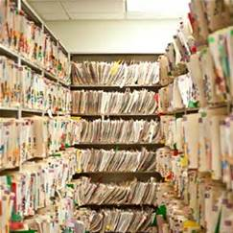
Special thanks
from the MUJHU
records clerks

Slide 32


Slide 33



Acknowledgements
MU-JHU Site Leadership
MUJHU HOPE Study Staff
The Microbicide Trials Network is funded by the National Institute of Allergy and Infectious Diseases UM1AI068633, UM1AI068615, UM1AI106707), with co-funding from the Eunice Kennedy Shriver National Institute of Child Health and Human Development and the National Institute of Mental Health, all components of the U.S. National Institutes of Health.

