Slide 1
Rave Basics and General Navigation
HPTN 084 Study-Specific Training
Johannesburg, South Africa
April 9-12, 2018
Stephanie Beigel-Orme
Clinical Data Manager
SCHARP, HPTN SDMC

Slide 2
Overview
Generate PTIDs
Flow of Visit Folders and eCRFs
Visit Calendar
Add Event
Icons in RAVE
Entering and editing data
Audit Trail
Log eCRFs
Electronic Sign Off of eCRFs
Fun quiz

Slide 3
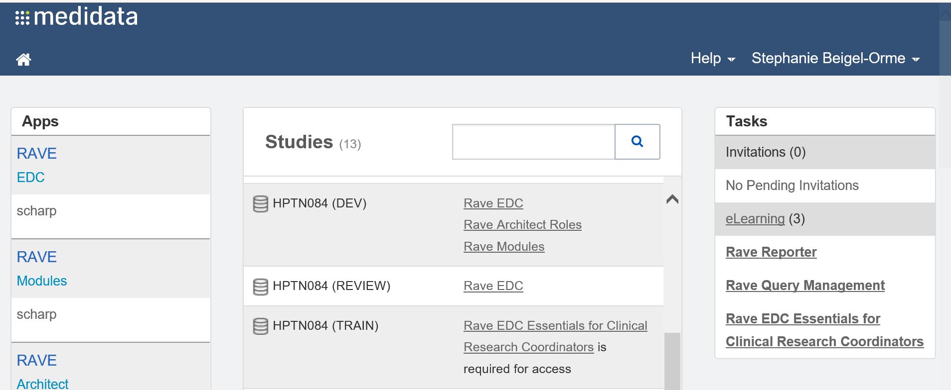
Navigate to HPTN 084 Database

Slide 4
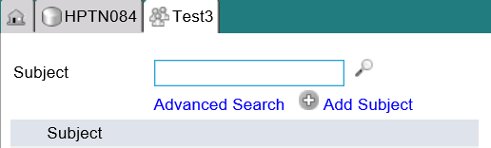
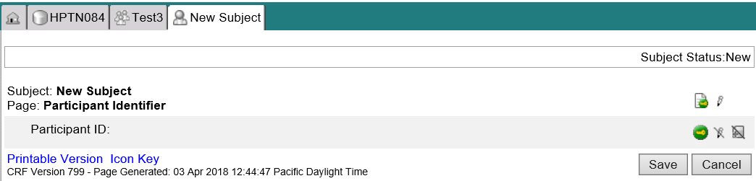
Generating the Participant’s ID (PTID)
Notes:
To generate the PTID, once you are on your site-home page, Clicking Add subject will take you to the Participant Identifier page. Clicking Save will automatically generate the PTID.
It should be noted you will see subject in lieu of participant within the Rave database. Rave calls subjects participants as part of its nomenclature but we will still refer to them as participants.

Slide 5
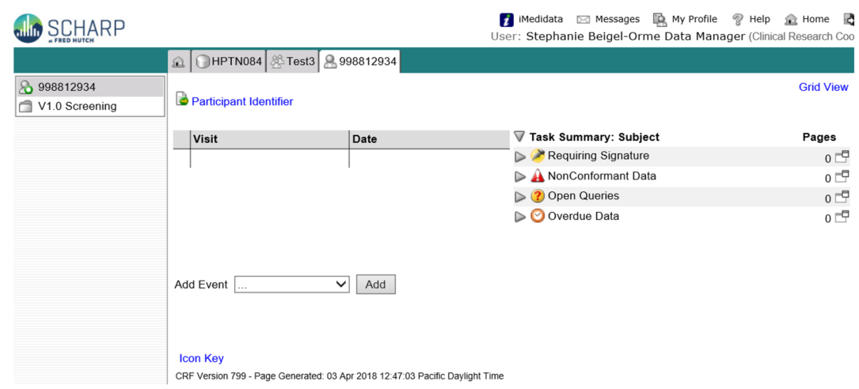
Participant Homepage
Notes:
So once the Subject ID/PTID is generated, you will taken to the Participant’s Homepage.
On the left side, you will see all of the visit folders for the participant.
On the participant’s homepage, you will also see a CRF History column displaying the most recent history of PTIDs and forms, which may be useful if you need to navigate back to a previous form.

Slide 6
Participant Homepage
Notes:
So once the Subject ID/PTID is generated, you will taken to the Participant’s Homepage.
On the left side, you will see all of the visit folders for the participant.
On the participant’s homepage, you will also see a CRF History column displaying the most recent history of PTIDs and forms, which may be useful if you need to navigate back to a previous form.

Slide 7
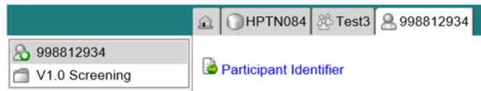
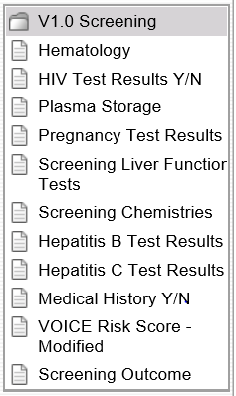
Flow of Visit Folders and eCRFs- Screening
Once a PTID is generated, the V1.0 – Screening folder appear in the Participant Casebook:

Slide 8
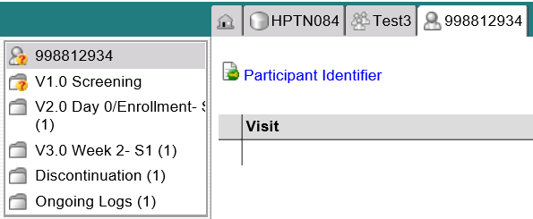
Flow of Visit Folders and eCRFs- Screening
If participant meets all eligibility and criteria and screening criteria:
  Key Question on Screening Outcome eCRF: “Will the participant enroll in the study?” is ‘Yes’
    V2.0-Enrollment, V3.0 Week 2, Discontinuation and Ongoing Logs folders are added to participant casebook:

Slide 9
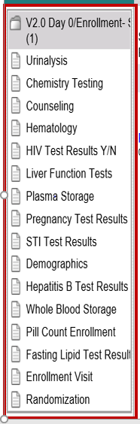
Flow of Visit Folders and eCRFs- Enrollment
Enrollment eCRFs
  Randomization must be completed for all further folders to populate

Slide 10
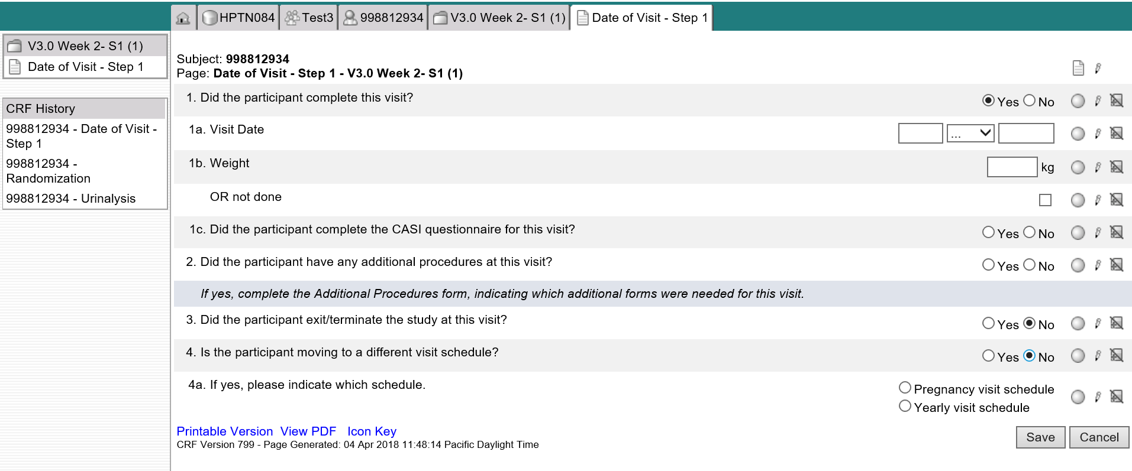
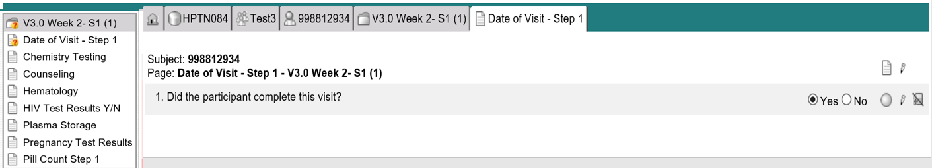
Flow of Visit Folders and eCRFs
Each follow-up visit eCRFs and folder will be dynamically added based on a trigger questions from the previous visit using “Date of Visit” eCRFs.
  Key Question 1: “Did the participant complete this visit?” is ‘Yes’

Slide 11
Flow of Visit Folders and eCRFs
Date of Visit eCRFs Key Question 2:
  “Did the participant exit/terminate the study at this visit?” is ‘No’

Slide 12
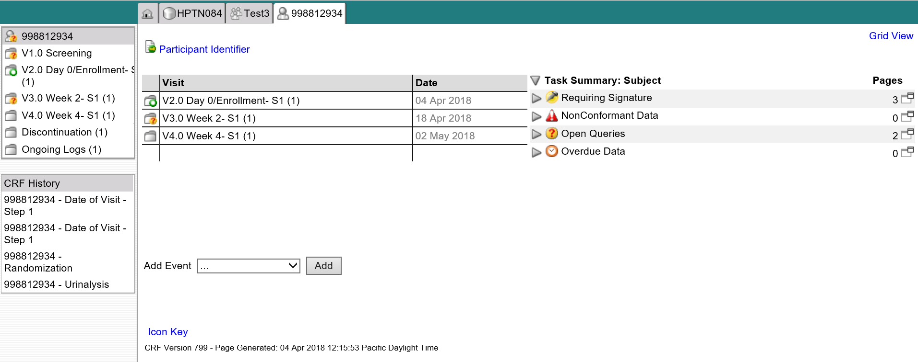
Flow of Visit Folders and eCRFs
V4.0 Week 4 folder is created

Slide 13
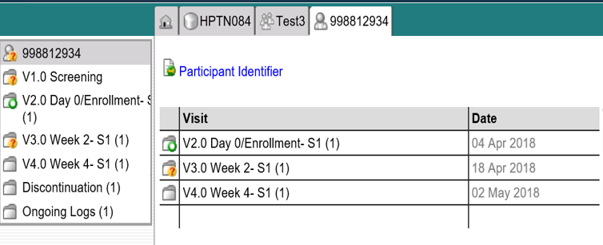
Visit Calendar
  Based off Randomization date
  Calculates visit calendar based on target dates
  Actual visit dates will populate once a visit is completed

Slide 14
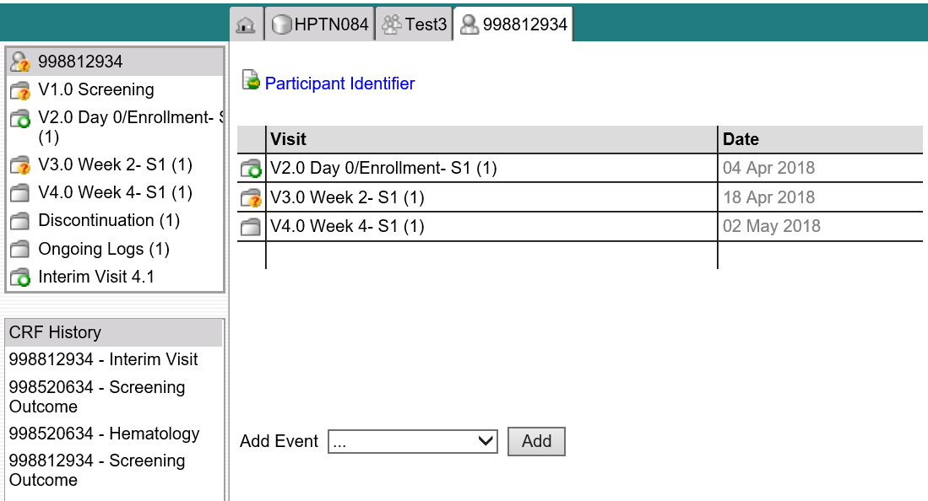
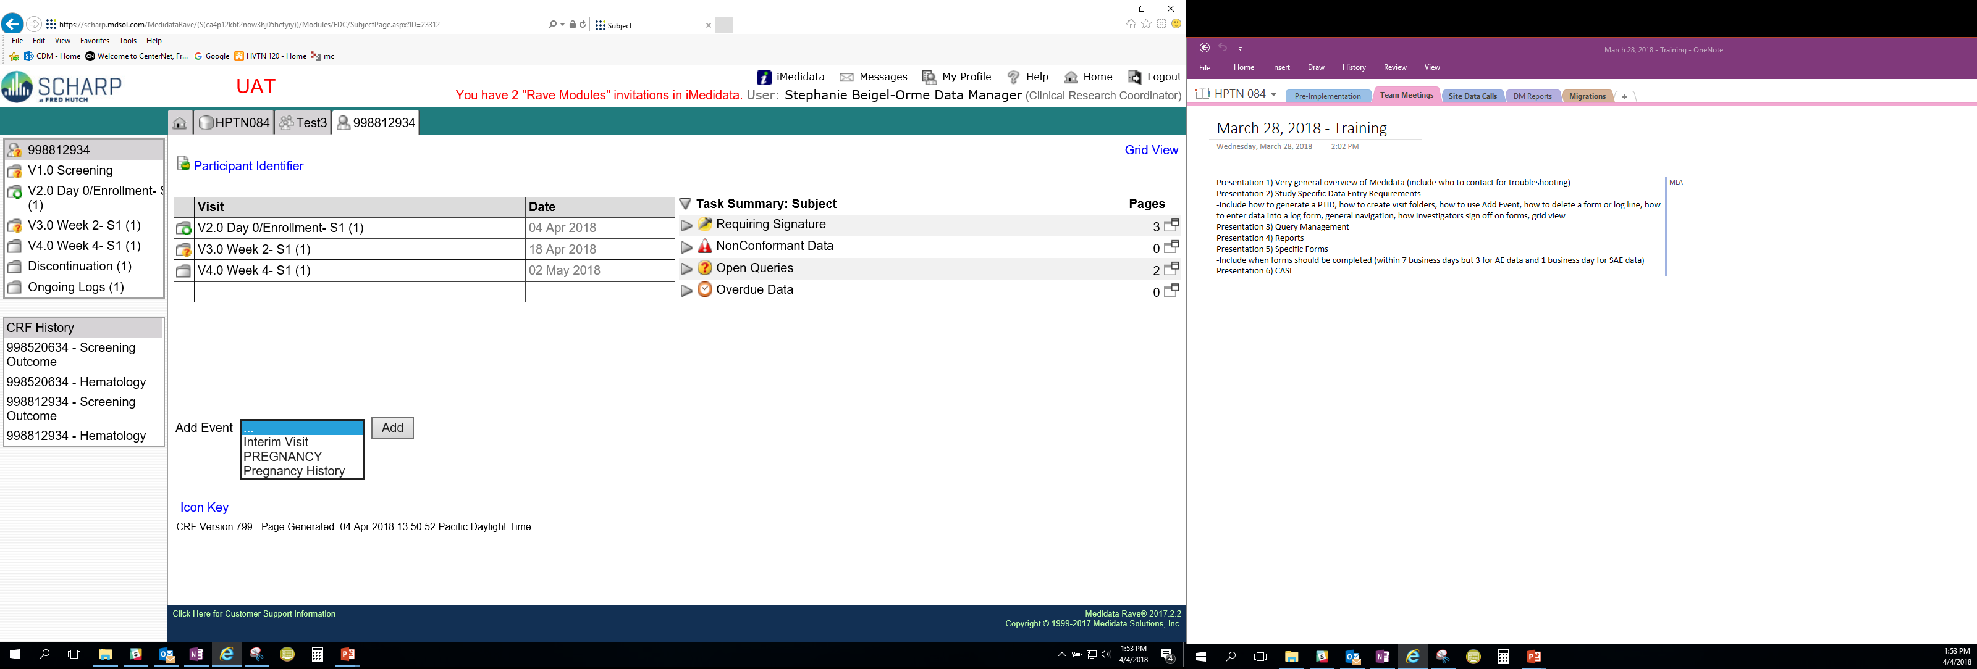
Add Event – Interim Visit
In “Add Event” feature select “Interim Visit” from drop down menu and then select “Add” button.
An Interim Visit Folder will populate with the Interim Visit eCRF.

Slide 15
Participant Homepage
Notes:
So once the Subject ID/PTID is generated, you will taken to the Participant’s Homepage.
On the left side, you will see all of the visit folders for the participant.
On the participant’s homepage, you will also see a CRF History column displaying the most recent history of PTIDs and forms, which may be useful if you need to navigate back to a previous form.

Slide 16
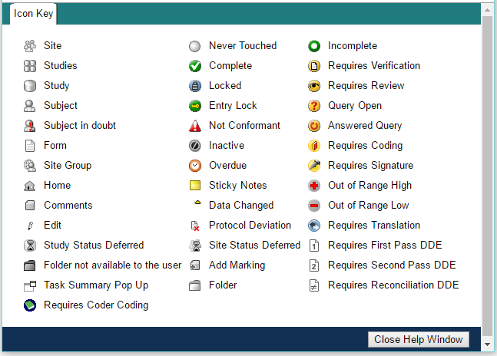
Icons Within Rave
Notes:
This is a listing of all of the icons that you may see within Rave. Icons may appear within the Task Summary or within different pages within Rave.
A few examples:
Delta symbol – data has been changed/updated
Incomplete = value entered for data point is incomplete and does not comply w requirements.

Slide 17
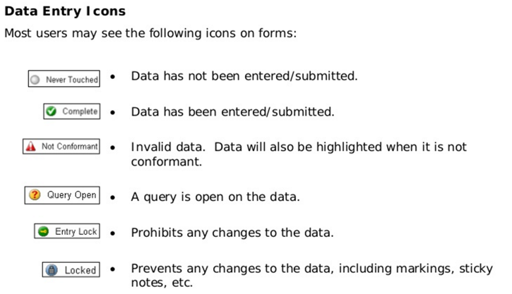
Data Entry Icons
Notes:
A few more examples of common icons you may see throughout the data entry process.
Untouched = data point has not been entered
Complete = data entered for field or data point is complete and complies with requirements
Non-conformant data: data not entered in expected format (e.g., entering “25” for month). Resolved when valid response (i.e., expected format) is entered and saved.
Open query = open query exists for data point that has not been answered.
Entry locked = Data point has been locked
Locked = data point or associated queries cannot be changed

Slide 18

Entering Data
All entered data must be saved.
All required fields must be completed.
Sites can save an incomplete eCRF and return to it later to enter remaining data.
  When you click save, those fields not completed will turn pink to indicate data is missing.
Once an eCRF is saved, any applicable edit checks will automatically be applied.

Slide 19

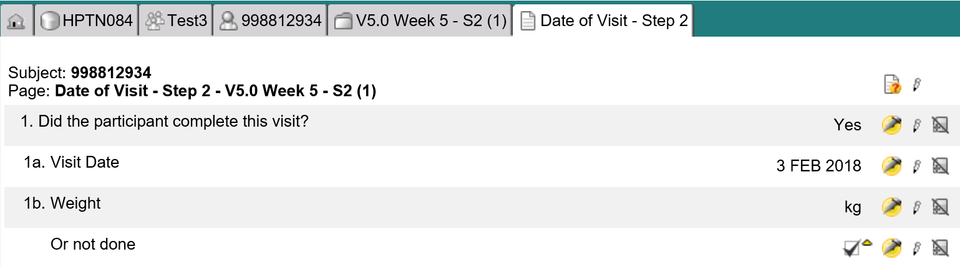
Updating Data: Use the pencil icon
Select ICON to edit eCRF item or entire eCRF
Recommended to use page level icon

Slide 20
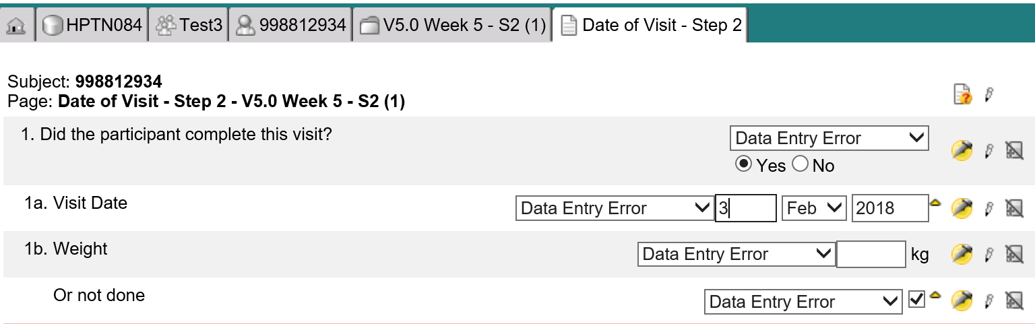

Updating Data: All fields may be edited

Slide 21
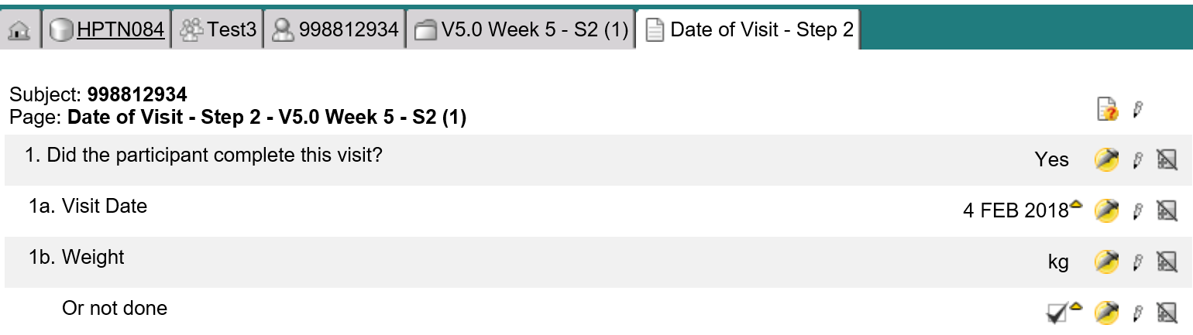
Field Audit Trail
All changes that have been made to a specific item can be viewed via the audit trail
To access an item’s audit trail, go to the completed form and click the data status icon.

Slide 22
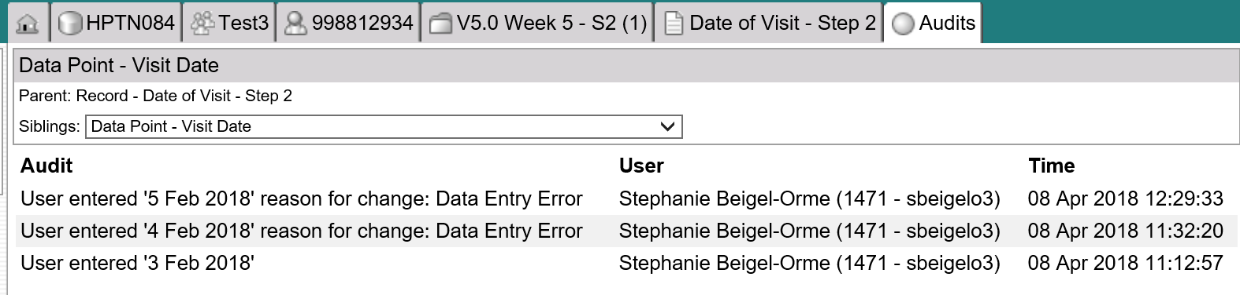
Field Audit Trail
  The audit trail shows each who enters data, responds to queries and has time stamp.

Slide 23
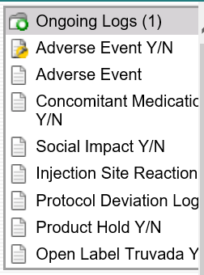
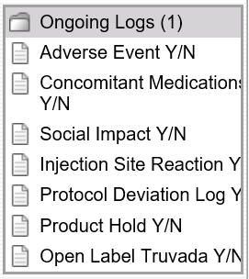
Log eCRFs
Most log forms are in “Ongoing Logs” folder as they are not tied to a visit.
Each log has a Yes/No eCRF if ‘Yes’ is indicated the log eCRF is created.

Slide 24
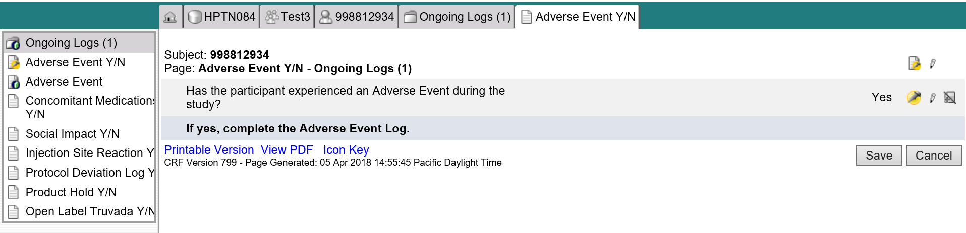
Log eCRFs

Slide 25
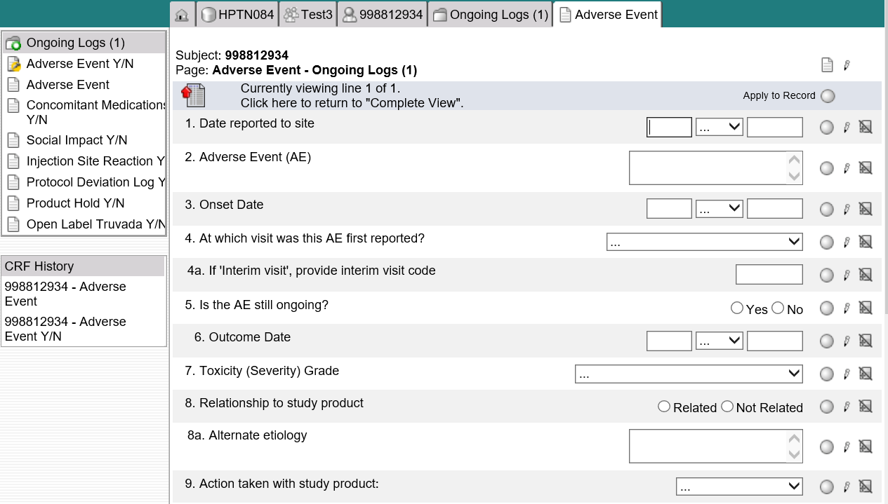
Log eCRFs
  Portrait View
  Once data are entered and saved displayed in “Complete View”
Portrait view: Used to enter data

Slide 26
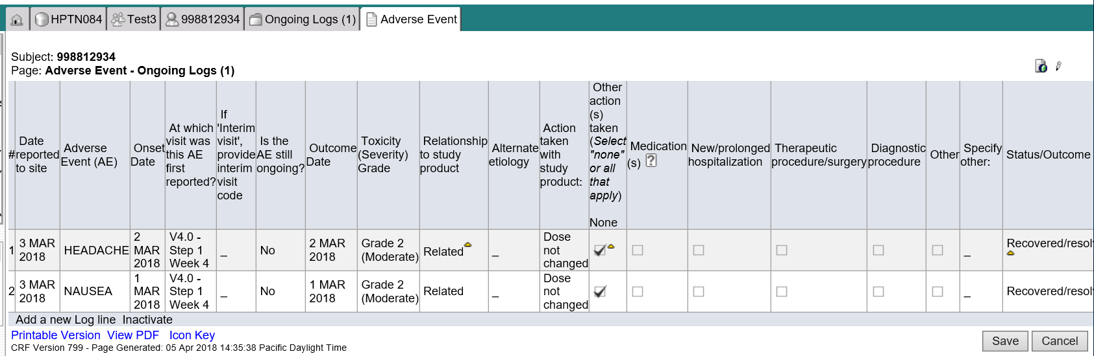
Log eCRFs- Complete View
Lands

Slide 27
Inactivating Log Lines
If a logline was entered in error, the entry can be inactivated.
When this occurs the data is not included in the analysis.
This data cannot be “edited” by the user.
To inactivate, click on the “Inactivate” link and select appropriate log.

Slide 28
Inactivating Log Lines

Slide 29
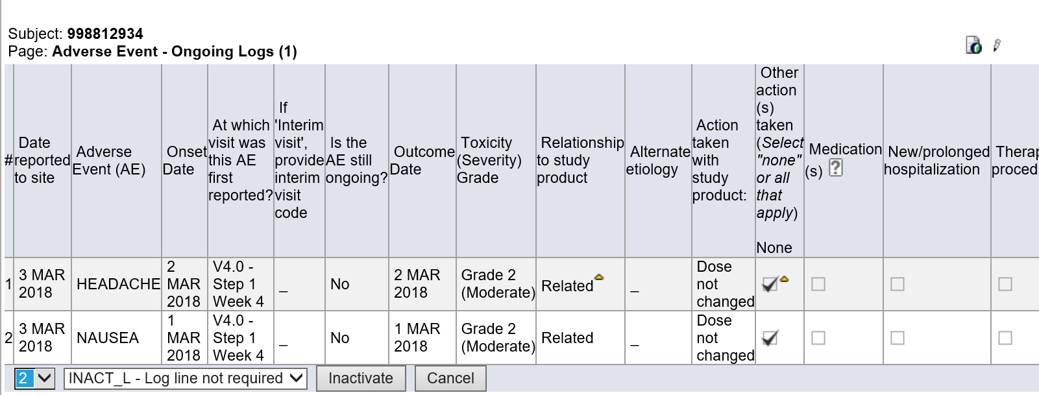
Inactivating Log Lines

Slide 30
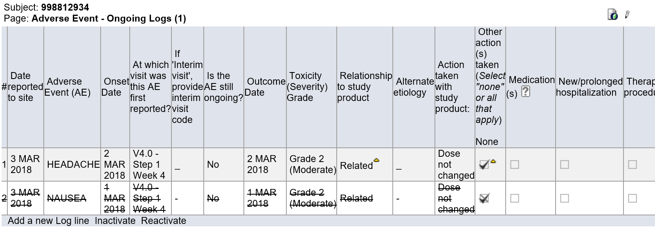
Inactivating Log Lines

Slide 31
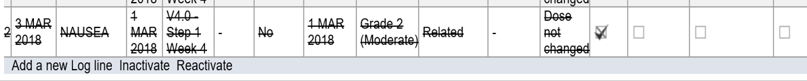
Reactivating Logs
If a log line is inactivated in error it can be reactivated.
Click on the “Reactivate” link and select appropriate log.
Once reactivated, all fields become editable and data is available for reports and analyses.

Slide 32

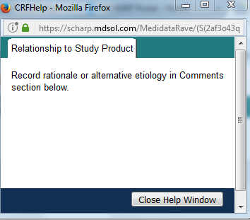
Help Text
Help text is available for some items on eCRFs to aid in form completion
Notes:
Clicking the question mark icon will open up a pop-up window with specific help text for certain items. We kept this limited and put this where it may be most useful (i.e. complicated skip patterns, if additional forms are needed based on a certain response, etc.). For full CRF completion guidelines, refer to CCGs.

Slide 33
Investigator Electronic Sign Off
Electronic form sign-off is performed by the Site Investigator (IoR) or designee to verify the completeness and accuracy of the participant's data.
  This individual must be listed on the Form FDA 1572 or DAIDS IOR Agreement Form.
All required data has been reviewed by the monitor and all queries are resolved.
SCHARP CDM(s) will notify you when the participants casebook is ready to sign.
Sign off can occur on a form level or casebook. Suggested to sign casebook as is more efficient.
Notes:
Site Investigators of Record (IoR) will electronically sign a form within Rave to verify the completeness and accurateness of the study data once data has been entered for that form and all queries associated with the form have been resolved. Site investigators can use the participant grid view to sign-off on multiple forms at a time. Each completed form within Rave must be electronically signed by the site investigator verifying completeness and accurateness of the study data. While investigators have the option to sign off on eCRFs at any point during the study once all queries have been resolved and prior to database lock, we recommend that form sign off towards the end of the study and during the study close out period for greatest efficiency. If forms are updated after an initial sign-off by the IoR, the eSignature is broken and the investigator will need to complete a second sign off of the form. The study SCHARP Clinical Data Manager will provide instruction on the optimal time for IoRs to provide eSignatures during study close out to avoid the need for multiple sign-offs for a given CRF.

Slide 34
Participant Grid View
To access, select “Grid View” located in the upper right corner of the participant’s main page.
Notes:
To access the participant grid view, navigate to the “Grid View” link located in the upper right hand side of each participant’s home (or calendar) page. This gives a good snapshot/overview of forms completed for ppt.

Slide 35
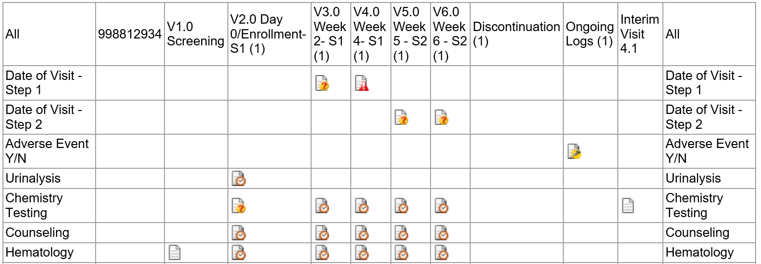
Participant Grid View
Lists all expected CRFs at each visit for a PTID
Can select forms by visit or can select entire casebook
Notes:
Here you will see that the grid view allows for you to view all folders and forms for a participant. Forms that have been completed or are expected to be completed will appear with an icon. If a form or a folder is not in participant’s visit folder, the cell will appear empty. For example, forms not required at Screening are left blank.
The same status icons that we reviewed for each item within an eCRF appears within Grid View as well. These icons show whether the form is completed, is overdue, locked, has queries, and so on.
You can navigate to the page view of each form listed to view the data recorded on each form by clicking on the icon.

Slide 36

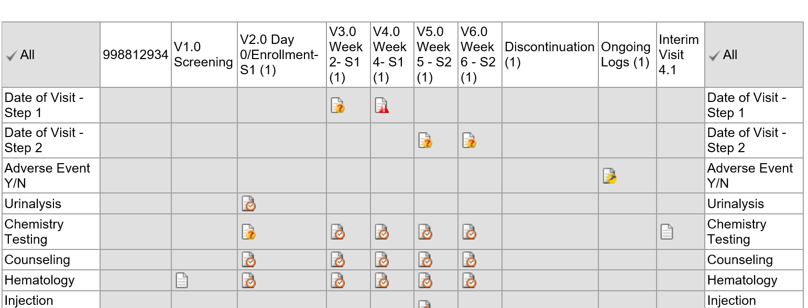
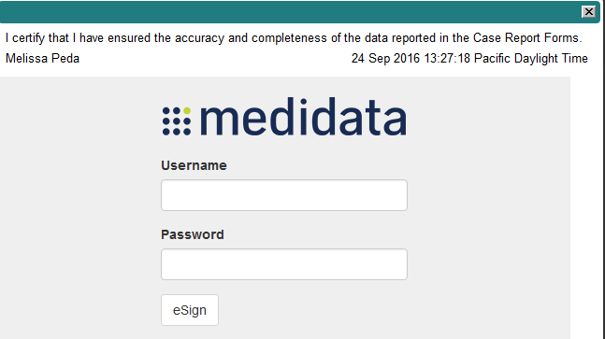
Participant Grid View- e Sign
Site investigators complete electronic sign off for multiple forms by selecting a row or column and clicking “Sign and Save”.
Signature prompt will display alongside a user ID and password text box
Notes:
Site Investigators of Record (IoR) will electronically sign a form within Rave to verify the completeness and accurateness of the study data once data has been entered for that form and all queries associated with the form have been resolved. Site investigators can use the participant grid view to sign-off on multiple forms at a time. You can tell if a form is ready to be signed by the yellow icon with a pen that denotes that the form is requires a signature.
Site investigators can sign the following from the grid view:
An individual folder or a form
All folders and forms in a study
All forms at the Subject level
The Sign and Save button appears if you select a form or folder that is ready to be signed within the grid. For example, by clicking on the “Ongoing Logs” column within the grid, an investigator can sign off on all forms completed with the ongoing logs folder for a given participant rather than completing page by page sign-off. When the “Sign and Save” is selected, the signature prompt displays alongside a userID and password text box for your signature.

Slide 37
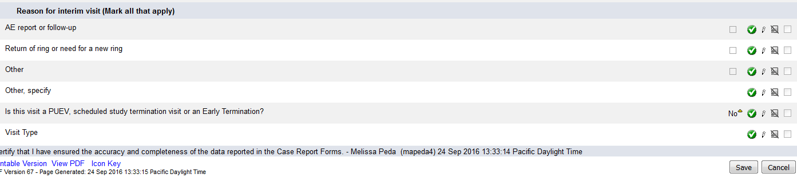
Participant Grid View – Investigator Role
IoR signature displayed on bottom of each eCRF.
This is the last step needed to lock a participants’ casebook.
All participants require sign off to lock the database.
Notes:
IoR can also sign off on one form per PTID. This is the last step needed to lock a participants’ casebook. All ppts need this sign off to lock the entire database.

Slide 38
PTIDs are generated automatically
True
False
ANSWER: True – PTIDs are generated by Rave

Slide 39
How do you add an Interim Visit folder?
ANSWER:
Use Add Event feature

Slide 40
How do you update or edit data?
ANSWER:
Click the pencil icon to open the data field

Slide 41
When should the IoR sign-off on eCRFs?
Upon completion of form
After each visit
As directed by SCHARP CDM
ANSWER: C

Slide 42
QUESTIONS?
Notes:
What questions can I answer for you?

