Slide 1
Getting Started With Rave
HPTN 084 Study-Specific Training
Johannesburg, South Africa
April 9-12, 2018
Stephanie Beigel-Orme
Clinical Data Manager
SCHARP, HPTN SDMC

Slide 2
Overview
What is Medidata Rave?
Why Rave?
Getting Started with Rave
Resources

Slide 3

What is Medidata Rave?
  Electronic data capture (EDC) platform for the capture, management and reporting of clinical, operational and safety data.
  Hosted on-line with a web-based interface
  Industry “gold standard” system

Slide 4
Why Medidata Rave?
Data Accuracy
Real-time data & consistency checks Legible entries Automatic calculations Better data management quality performance
Regulatory Compliance
Validated system Data integrity 21 CFR Part 11 (Electronic Records, Electronic Signatures) Electronic source data verification (monitors) CDISC/SDTM output Submission-ready data
Efficient Data Management
Data entry at sites Real-time data access Less time managing queries
Organization
User-friendly navigation Search and filter options Reports Greater visibility
Data Security
Data protected Data backed up User and role-specific permissions

Slide 5
Why Medidata Rave?
Sites can enter data straight from paper source into Rave
Sites can check and resolve errors, inconsistencies, and missing data in real time at the point of site data entry
Communication, query guidance applied by CDM and Safety to sites directly within Rave
Audit trail captures all changes made to a CRF with Rave

Slide 6
Technical Requirements
To access and use Medidata Rave, sites need:
  Internet-enabled computer/laptop/tablet
  Stable internet connection
  Web browser
Lesson learned from HPTN Regional meeting
  Invest in robust internet connectivity and computers
Notes:
At regional meeting some lessons learned are that have come up are basically to invest in the infrastructure for your success.

Slide 7
Getting Started: User Accounts
Sites will complete a form with site staff names, contact information, and site roles for access to Rave
SCHARP will set up user accounts
An email invitation from Medidata will be sent to set up a user accounts

Slide 8
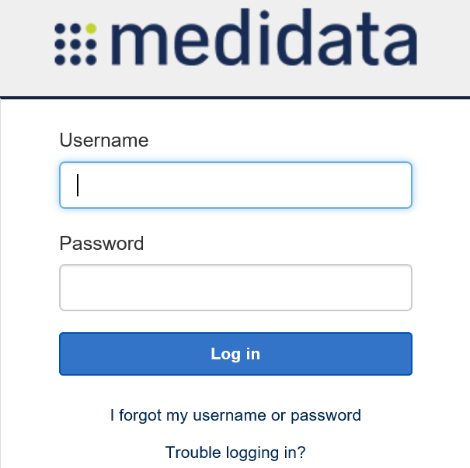
Rave Navigation
Access Rave at www.imedidata.com
Notes:
Refer to the HPTN084 Start Up slide deck for information regarding user account set up and completion of required eLearnings. These slides provide guidance on accessing the study production database for data entry during participant visits.

Slide 9
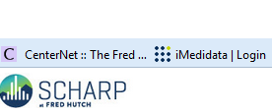
Rave Navigation Tip
Bookmark as a favorite on your web browser
Same URL/address for other network studies (MTN, PTN, VTN)

Slide 10
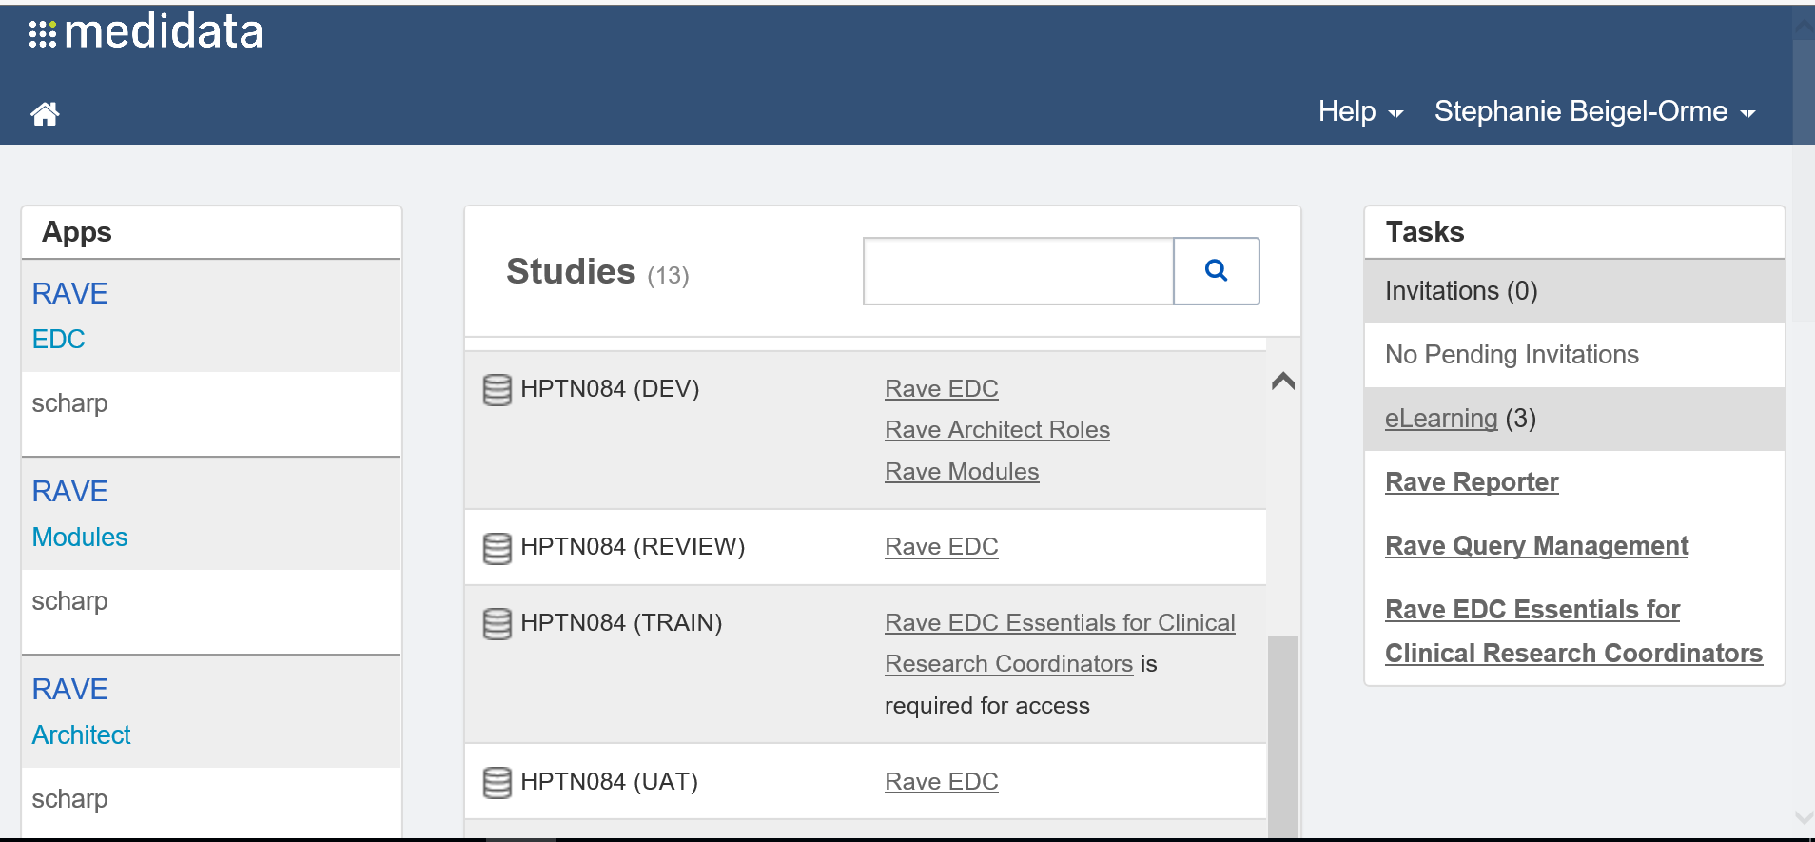
Complete eLearning Modules
Assigned eLearning modules are user-specific, based on role assigned by SCHARP
Links to eLearning modules will appear

Slide 11
Complete eLearning Modules
Click each module to run the course
  Completion is required to access the HPTN084 database
  Exercises are included in each module
Credit for completion applies across all studies in Rave (only need to complete each module once)
    Single account for all Rave network studies (HPTN, MTN and HVTN)

Slide 12
Site Roles in Rave
Assigned eLearning modules and Rave permissions based on roles assigned in Medidata
Clinical Research Coordinator
Enter participant data
Resolve queries
Principal Investigator
Enter participant data Resolve queries
Review and sign eCRFs
Site Pharmacist
Retrieves participant arm information from BALANCE

Slide 13
Resources Within Rave
Resource Pane:
Found on bottom left side of home screen
Displays a list of internet links that are standard across HPTN, MTN, and HVTN studies:
  DAIDS AE Grading Table v2.1

Slide 14
Resources Within Rave
iMedidata Portal – Help menu on upper-right corner provides access to these functions:
Help On This Page – Click to open Online Help for the current application page in a new tab.
Knowledge Space Home – Click to open the top level Help page in a new tab.
Show Me Videos – Click to open a new tab where you can view a short instructional video about iMedidata.
Help Center – Click to open a page that allows you to view documentation and helpful tips as well as to report a problem

Slide 15
Other Resources
Data Management SSP
CRF Completion Guidelines (CCGs)
Medidata Rave materials posted on HPTN084 Atlas page
  https://atlas.scharp.org/cpas/project/HPTN/084/begin.view?

Slide 16
Resources
HPTN084 database, randomization, or CRF-specific questions, contact SCHARP CDMs:
  Laura McKinstry (lamckins@scharp.org)
  Stephanie Beigel-Orme (sbeigelo@scharp.org)
General Medidata system issues (i.e., Rave offline, or for password reset), contact Medidata:
  helpdesk@mdsol.com or 1-866-MEDIDATA

Slide 17
QUESTIONS?
Notes:
What questions can I answer for you?

